Slide 1
Cloud Computing
Course Level – Basic

Slide 2
About the Course Creators
Course Name | Cloud Computing
Course Author Name : | Aneesh C P
About the Author : | Senior Technical Trainer - L & D
Date of Creation | 09-Jan-2024

Slide 3
After completing this course, the participants will be able to understand ……
What is Cloud Computing?
What is Azure?
What are the Azure Prominent Services?
Course Learning Objectives

Slide 4
What is cloud computing ?
What are data centers?
Who are the top cloud providers ?
What are the common cloud applications you use ?
Do You Know?

Slide 5
Pre-Test
S.No | Question | Answer Options
1 | Which of the following is not a cloud application ? | Notepad Google Slides Google Docs
2 | Youtube application is Cloud | True false

Slide 6
Pre-Test
S.No | Question | Answer Options
3 | All cloud services are free to use | True false

Slide 7
Cloud Computing Basics

Slide 8
Cloud computing is the on-demand, pay-as-you-go service distribution model over the Internet. Instead of purchasing, operating, and maintaining physical data centres and servers, you may rent computing power, storage, and databases from a cloud provider.
The term "Cloud" simply refers to the internet. Computing is the architecture and techniques that allow a computer to execute, create, distribute, and interact with data.
This means that, rather than hosting infrastructure, systems, or programs on your hard drive or on an on-site server, you host them on virtual/online servers that connect to your computer via secure networks.
What is Cloud Computing ?

Slide 9
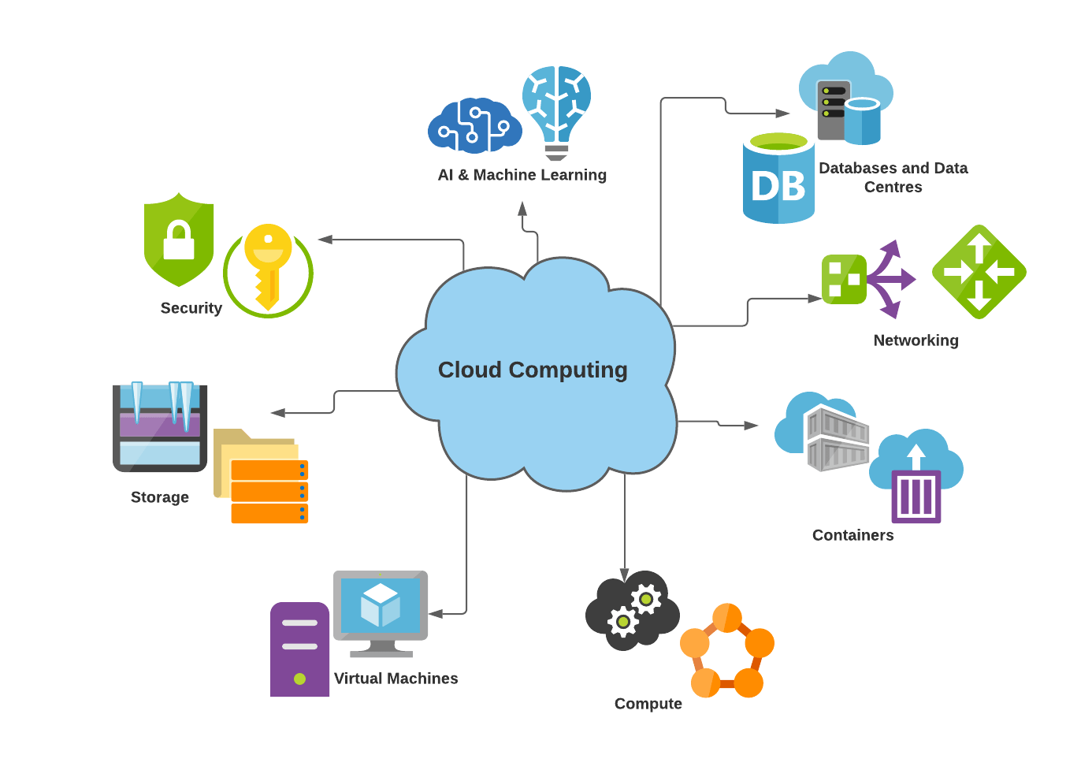


What is Cloud Computing ?
Data Centers

Slide 10
Organizations of every type, size, and industry are using the cloud for a wide variety of use cases, such as data backup, disaster recovery, email, virtual desktops, software development and testing, big data analytics, and customer-facing web applications.
Examples :
Healthcare companies are using the cloud to develop more personalized treatments for patients.
Financial services companies are using the cloud to power real-time fraud detection and prevention.
Video game makers are using the cloud to deliver online games to millions of players around the world.
Who uses Cloud Computer ?

Slide 11
Reason #1 : Agility
The cloud gives you easy access to a broad range of technologies so that you can innovate faster and build nearly anything that you can imagine. You can quickly spin up resources as you need them–from infrastructure services, such as compute, storage, and databases, to Internet of Things, machine learning, data lakes and analytics, and much more.
You can deploy technology services in a matter of minutes, and get from idea to implementation several orders of magnitude faster than before. This gives you the freedom to experiment, test new ideas to differentiate customer experiences, and transform your business.
Why Cloud ? ( The Benefits )

Slide 12
Reason #2 : Elasticity
With cloud computing, you don’t have to over-provision resources up front to handle peak levels of business activity in the future. Instead, you provision the amount of resources that you actually need. You can scale these resources up or down to instantly grow and shrink capacity as your business needs change.
Reason #3 : Cost savings
The cloud allows you to trade fixed expenses (such as data centers and physical servers) for variable expenses, and only pay for IT as you consume it. Plus, the variable expenses are much lower than what you would pay to do it yourself because of the economies of scale.
Why Cloud ? ( The Benefits )

Slide 13
Reason #4 : Deploy globally in minutes
With the cloud, you can expand to new geographic regions and deploy globally in minutes.
For example, AWS has infrastructure all over the world, so you can deploy your application in multiple physical locations with just a few clicks.
Putting applications in closer proximity to end users reduces latency and improves their experience.
Why Cloud ? ( The Benefits )

Slide 14
Cloud Computing Types Types

Slide 15
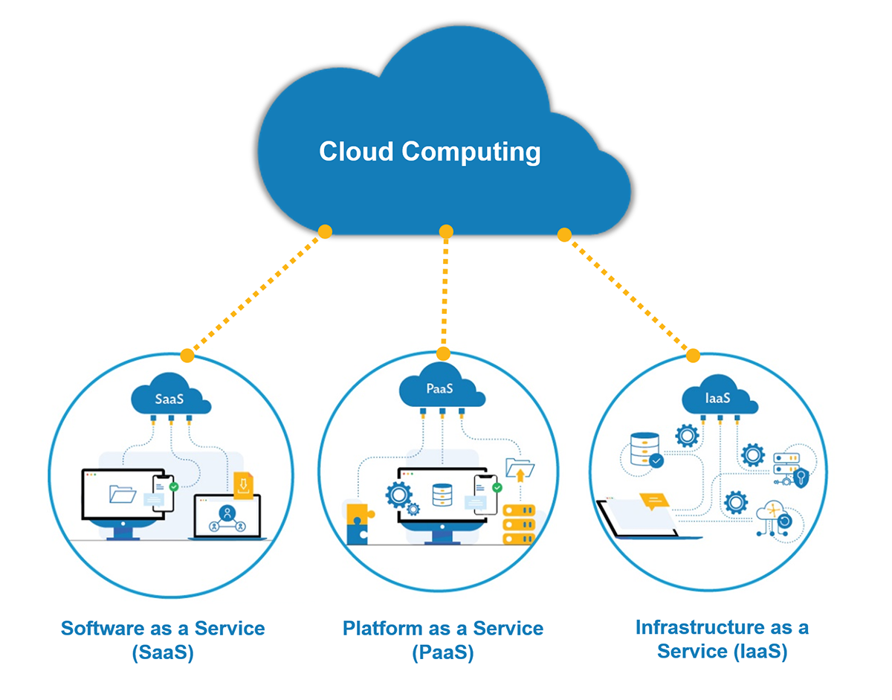
The three main types of cloud computing include Infrastructure as a Service(IaaS), Platform as a Service(PaaS), and Software as a Service(SaaS). Each type of cloud computing provides different levels of control, flexibility, and management so that you can select the right set of services for your needs.
Types of cloud computing

Slide 16
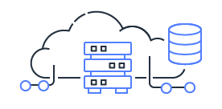
Infrastructure as a Service, sometimes abbreviated as IaaS, contains the basic building blocks for cloud IT and typically provide access to networking features, computers (virtual or on dedicated hardware), and data storage space.
Infrastructure as a Service provides you with the highest level of flexibility and management control over your IT resources and is most similar to existing IT resources that many IT departments and developers are familiar with today.
Examples :
DigitalOcean
Amazon Web Services (AWS)
Cisco Metapod
Microsoft Azure
Infrastructure as a Service (IaaS)

Slide 17
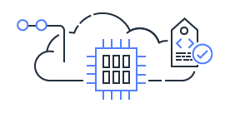
Platforms as a service remove the need for organizations to manage the underlying infrastructure (usually hardware and operating systems) and allow you to focus on the deployment and management of your applications.
This helps you be more efficient as you don’t need to worry about resource procurement, capacity planning, software maintenance, patching, or any of the other undifferentiated heavy lifting involved in running your application.
Examples:
AWS Elastic Beanstalk
Windows Azure
Google App Engine
OpenShift
Platform as a Service (PaaS)

Slide 18
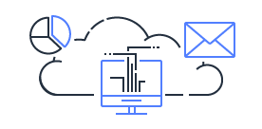
Software as a Service provides you with a completed product that is run and managed by the service provider. In most cases, people referring to Software as a Service are referring to end-user applications.
With a SaaS offering you do not have to think about how the service is maintained or how the underlying infrastructure is managed; you only need to think about how you will use that particular piece of software.
A common example of a SaaS application is web-based email where you can send and receive email without having to manage feature additions to the email product or maintaining the servers and operating systems that the email program is running on.
Examples :
Office 365
Google Sheets
SalesForce
Software as a Service (SaaS)

Slide 19
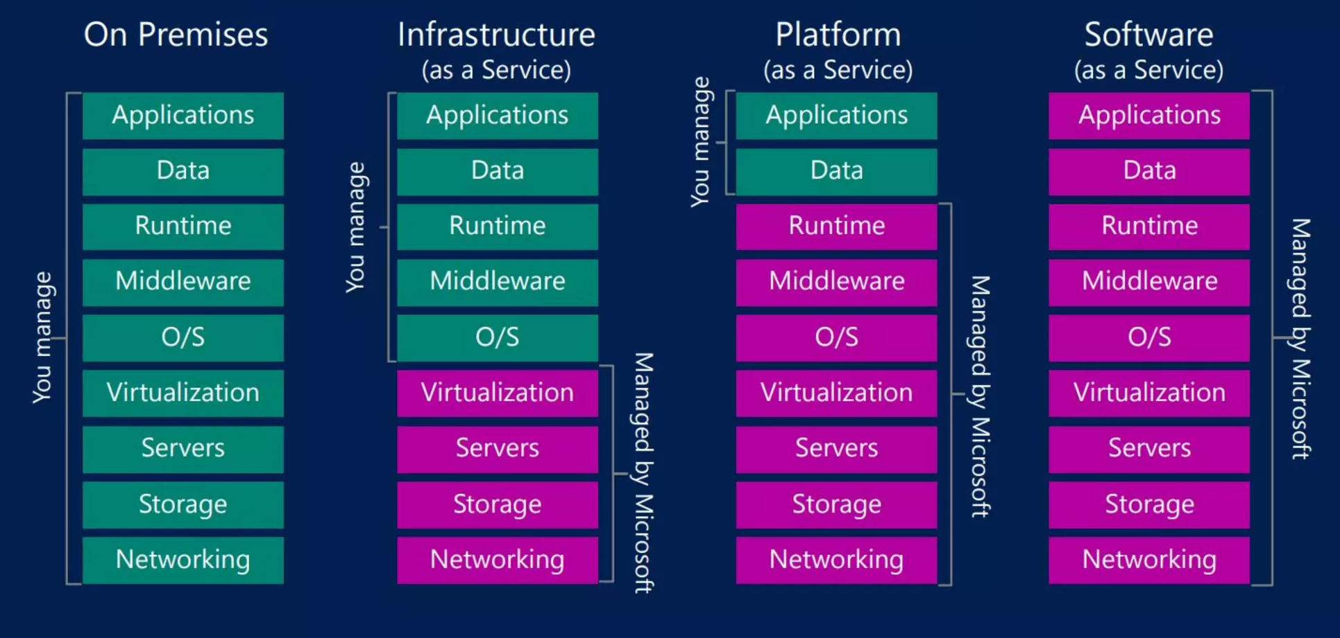
Cloud Computing Types

Slide 20
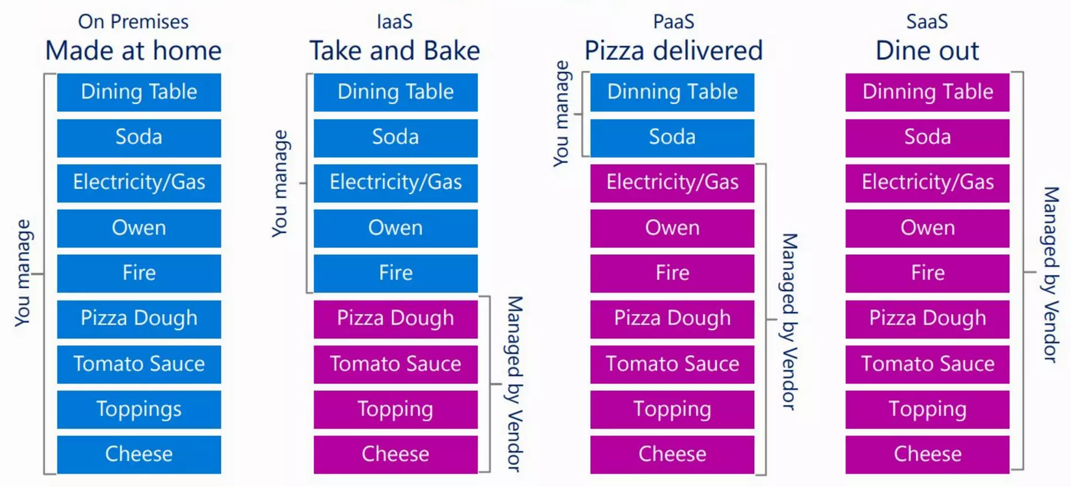
Cloud Computing Types

Slide 21
Drivers of Cloud Solutions

Slide 22
What drives a business to the cloud?
A business driver is an interface or resource used for the development and success of the business. They are the inputs that drive the businesses operationally and financially to achieve the organizational goals.
Following are the top 10 business drivers that are leading companies to cloud adoption:
#1.Security:
Security is one of the main reasons businesses are moving to the cloud. As cyber-attacks increase, companies want to bolster cybersecurity by moving to modern platforms. Phishing and Malware attacks have also grown to be more sophisticated and are very difficult to combat. Cloud computing makes the business more secure against all these invading threats, and hence it is a key business driver for cloud adoption.

Slide 23
What drives a business to the cloud?
2) Cost Saving:
Hardware, storage, and network devices for an on-premises data center require a considerable investment. With the cloud, your capital expenditure (CapEx) gets reduced significantly. The pay per use cloud model enables you to pay only for what you use and thus saves a big chunk of your investment which you can use in other productive pursuits of business expansion.
3) Efficiency:
Efficiency removes unnecessary steps to streamline the process. It increases productivity and gives a faster customer delivery approach.
4) Flexibility and Scalability:
Your computing services increase with your business growth. Maintaining them on your means increased costs and new infrastructure. But with the cloud, you can purchase more storage to meet your needs and have instant access to expanded capabilities. Cloud solutions are highly flexible and scalable.

Slide 24
What drives a business to the cloud?
5) Rapid recovery:
If you store your data on-premises, you need to have a replication of it on some other location, and if that is not done, then you have to replace the entire infrastructure if a disaster strikes. Both these things prove very costly. But with cloud backup, your data is stored across several storage centers, and so even when a disaster strikes at one of the centers, it can be overcome quickly, thanks to the other storage centers and backups.
6) Increased Convenience:
Cloud-based storage enables users to easily access the files they need, wherever they are stored. It becomes more convenient for the employees to use the technology and focus on other tasks leading to business growth.
7) Speed and Productivity:
It takes weeks or months to get new applications to run on traditional platforms. But in the cloud, it is a matter of hours. This reduces your time significantly and thus increases your productivity.

Slide 25
What drives a business to the cloud?
8) Strategic value:
Migrating to the cloud gives a competitive edge to businesses as they can give their clients and customers innovative technologies that are easily accessible. With the cloud, organizations can provide their customers with quick solutions and thus increasing business agility and customer satisfaction.
9) Multi-tenancy:
Cloud servers are architected so that several customers can share the underlying infrastructure resources without compromising their privacy and security.
10) Service and Innovation:
With the cloud, you can use many cloud services and application programming interfaces (APIs) and use flexible cloud tools and environments to build new and innovative applications and processes.

Slide 26
Types of Cloud Deployment

Slide 27
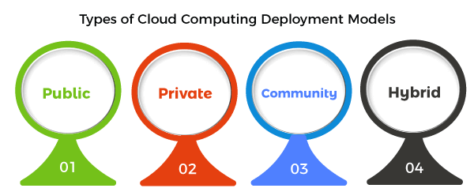
Types of Cloud Deployment
The Four types of Cloud Deployment Models are :
Public , Private, Community and Hybrid . Let’s discuss it on next slide

Slide 28
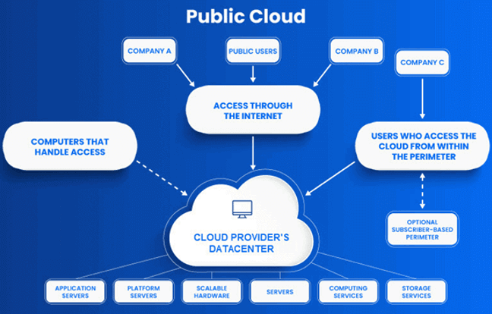
Deployment Types : Public Cloud Model
As its names suggest, the public cloud is available to the general public, and resources are shared between all users. They are available to anyone, from anywhere, using the Internet. The public cloud deployment model is one of the most popular types of cloud.

Slide 29
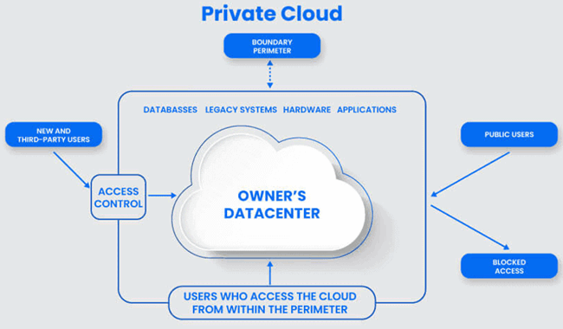
Deployment Types : Private Cloud Model
The private cloud deployment model is a dedicated environment for one user or customer. You don’t share the hardware with any other users, as all the hardware is yours.
It is a one-to-one environment for single use, so there is no need to share your hardware with anyone else. The main difference between private and public cloud deployment models is how you handle the hardware. It is also referred to as “internal cloud,” which refers to the ability to access systems and services within an organization or border.

Slide 30
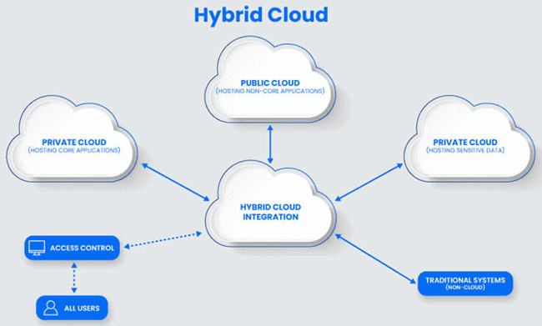
Deployment Types : Hybrid Cloud Model
A hybrid cloud deployment model combines public and private clouds. Creating a hybrid cloud computing model means that a company uses the public cloud but owns on-premises systems and provides a connection between the two. They work as one system, which is a beneficial model for a smooth transition into the public cloud over an extended period.
Some companies cannot operate solely in the public cloud because of security concerns or data protection requirements. So, they may select the hybrid cloud to combine the requirements with the benefits of a public cloud. It enables on-premises applications with sensitive data to run alongside public cloud applications.

Slide 31
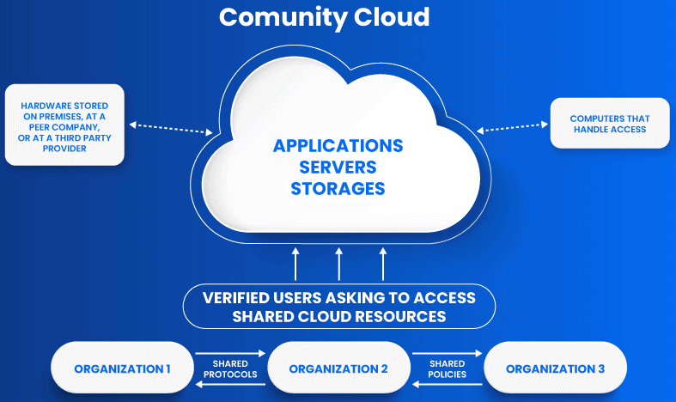
Deployment Types : Community Cloud Model
Community clouds are cloud-based infrastructure models that enable multiple organizations to share resources and services based on standard regulatory requirements. It provides a shared platform and resources for organizations to work on their business requirements.
This Cloud Computing model is operated and managed by community members, third-party vendors, or both. The organizations that share standard business requirements make up the members of the community cloud.

Slide 32
Cloud Security Management

Slide 33
Cloud security management is not a single concept or product. It is actually a complementary combination of strategies, tools and practices that are intended to help a business host workloads and data in a cloud efficiently and cost-effectively -- yet limit the threats and vulnerabilities that are often present in complex public networks as well as shared cloud resources and services.
Cloud security is a multifaceted endeavor that involves numerous efforts, including the following:
Authentication and authorization.
This is comprehensive user management based on cloud services, such as identity and access management (IAM), to ensure that any cloud users or devices are authorized to access workloads and data.
What is cloud security management?

Slide 34
Data security.
Use encryption to guard valuable business data against theft, loss, or other unauthorized access.
Suitable cloud architectures.
Compose cloud architectures and connect security services that are appropriate and properly configured for each workload being hosted.
Proper application configuration.
Beyond the proper configuration of cloud resources and services, each workload hosted in the cloud will also possess varied configuration options that must be set and maintained properly.
Monitoring and reporting.
Cloud security requires comprehensive tooling to guard against malicious activity, maintain data integrity, and produce real-time alerts and ongoing reporting in response to detected security issues.
What is cloud security management?

Slide 35
Cloud security can be complex and demanding, but there are important benefits that any enterprise should consider:
Better visibility :
Comprehensive and well-designed cloud security management can provide cloud users with detailed and documented insight into their cloud deployments. For example, users can obtain a reliable picture of the workloads and data present in the cloud, what resources and services are involved, how those resources and services are configured, who is accessing the workloads and data, and what data is being accessed.
Better compliance :
Visibility information can be priceless for ensuring regulatory compliance and performing forensic analysis of incidents. Business users can understand the factors involved in an incident, correct deficiencies and take decisive action to remediate the impact of an incident for customers and regulators.
What are the benefits of cloud security management?

Slide 36
Better tools :
Many cloud providers offer comprehensive security tools -- built specifically to operate within the providers' infrastructure -- which can scan, analyze, report and alert on potential security threats with a high degree of effectiveness. This alleviates the need for users to install and operate their own security applications or tools in the cloud.
Security services :
Cloud providers typically offer data encryption and other services, such as data loss prevention (DLP) designed to protect business data at rest and in flight. Other services such as data backups, recovery and disaster recovery (DR) can further help to protect vital business data in the cloud.
Lower security costs :
Businesses can often lower security costs and improve security effectiveness when using the security tools and services supplied through cloud providers
What are the benefits of cloud security management?

Slide 37
Cloud security faces an ever-growing array of challenges. Businesses that use the cloud (or are considering cloud deployment targets) should take the time to seriously consider many of the most important security challenges, including the following:
#1 . Shared responsibility :
Clouds operate on a shared responsibility model, but there are often misunderstandings about responsibilities and definitions that lead to critical gaps in security management. It's important to understand the shared responsibility model clearly and work with providers to ensure that each side meets its obligations.
What are the challenges of cloud security management?

Slide 38
#2.Limited visibility
If you can't see it, you can't manage it: It's an old axiom that perfectly suits cloud security efforts. A business must be able to see where all of their applications and data are located in the cloud, and this can be problematic with such decentralized control over different business teams and divisions that might use the cloud. There must be a means of discovering, tracking, and reporting on the assets present in the cloud.
#3. Compliance challenges
A business is obligated to know what assets it has available, where those assets are located, and how they're being used. When a cloud provider obscures this information (or a user does not bother to access this information), the business could experience a costly breach in regulatory compliance. It's important to understand the tools and visibility offered by a provider and to understand how that information can meet compliance requirements.
What are the challenges of cloud security management?

Slide 39
#4 .Limited control.
Businesses do not own the cloud infrastructure. While a user can assert considerable control over some security issues like user authorization and authentication, users typically do not assert control over the underlying cloud infrastructure as they would within a local data center. This can lead to security concerns in how data is accessed and shared.
#5 .Cloud differences.
Every cloud is different. As businesses explore hybrid and multi-cloud environments, there are bound to be differences in tools, services, configurations and capabilities that might cause an inconsistent or incomplete security posture for the business. This is another case where consultations with the providers can be extremely beneficial for business users.
What are the challenges of cloud security management?

Slide 40
Software Deployment in Cloud

Slide 41
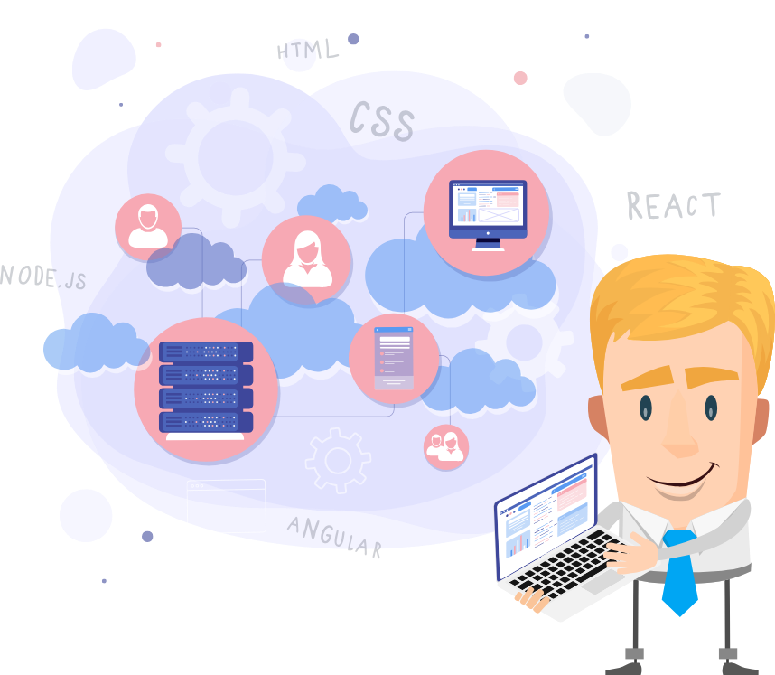
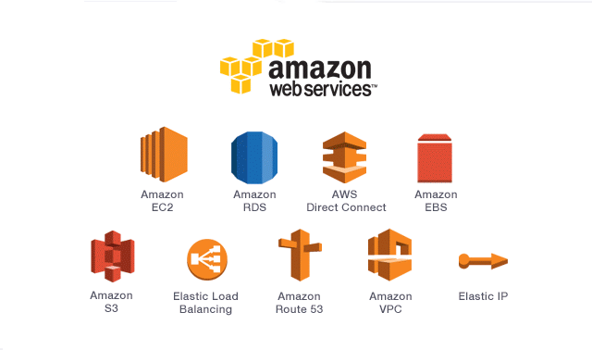
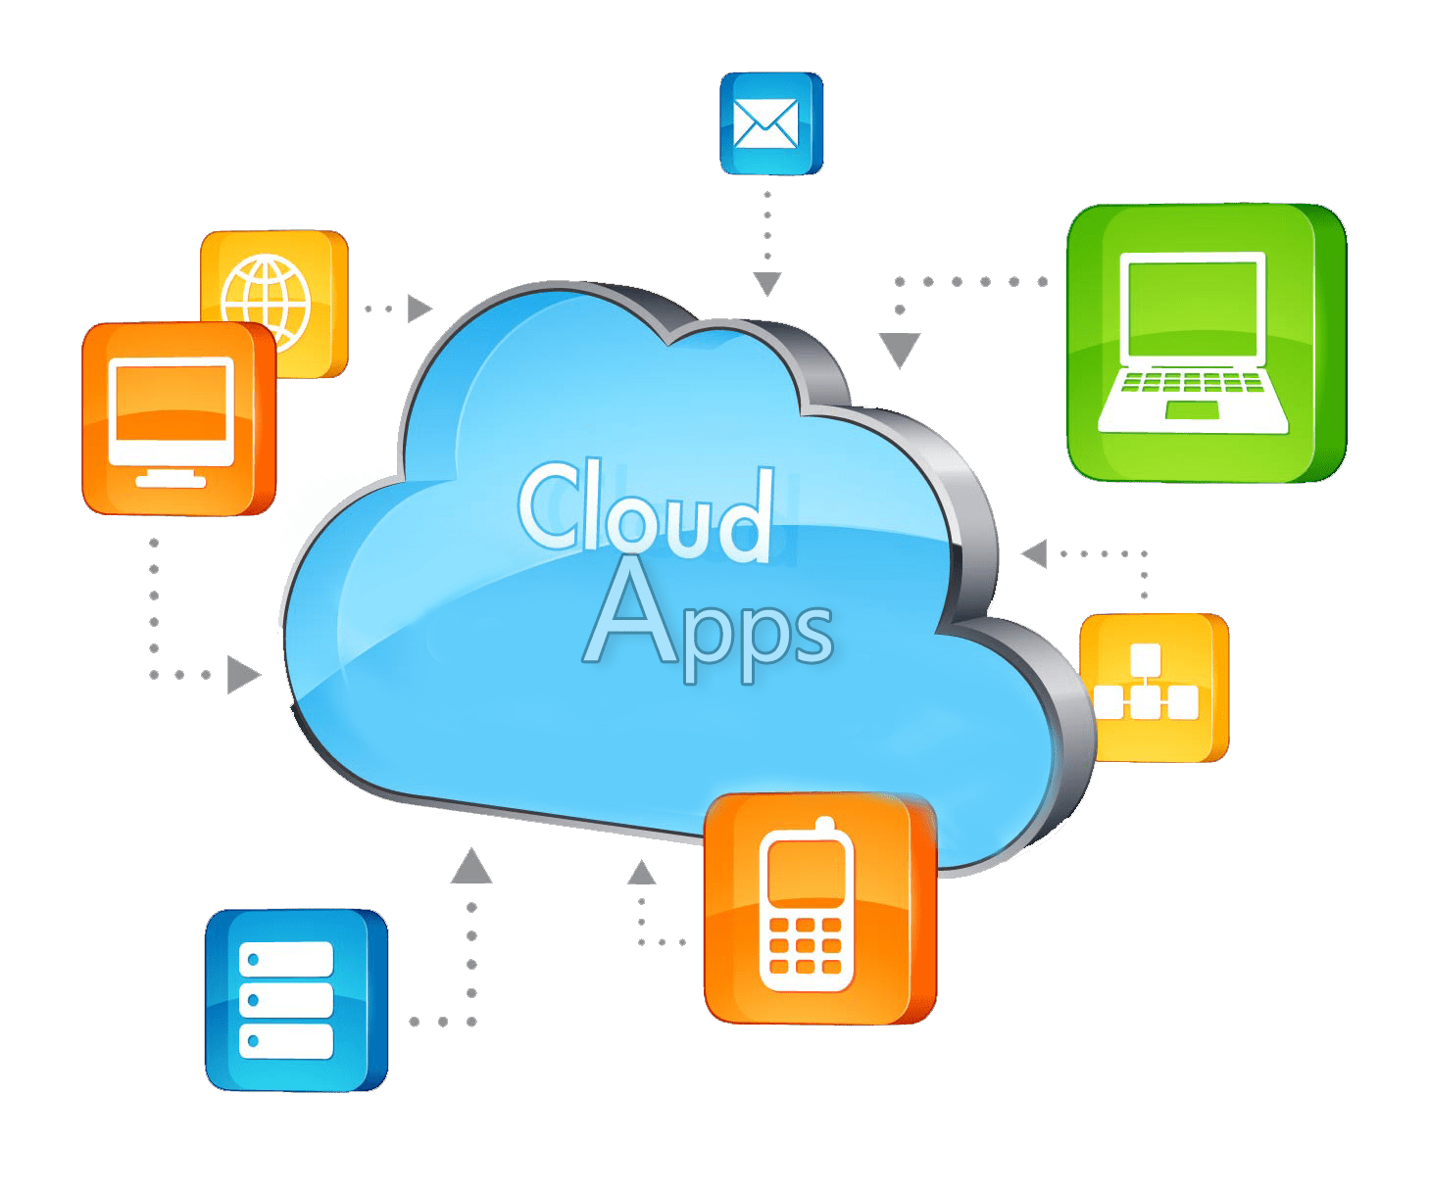
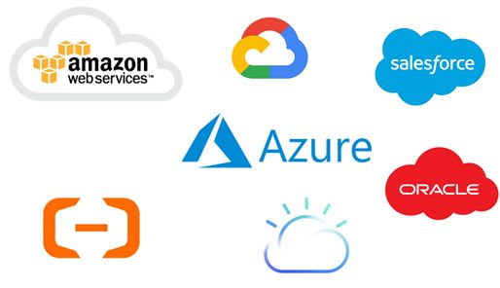
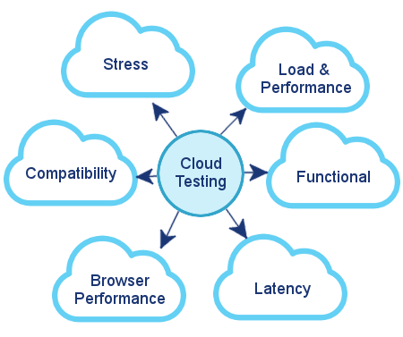
Following picture depicts the steps involved in deploying the software solutions to Cloud.
Deployment of software solutions on Cloud
Update and Improve Your Software
Choose the Provider
Prepare the Software
Launch Your Software
Configure your Cloud Provider
Test your Software

Slide 42
The following are the steps involved in deploying the software solutions and web applications to Cloud.
Step #1 : Choose the cloud provider
Select the cloud provider that suits your needs and budget . Consider the software architecture , tech stack used , security etc to choose the appropriate cloud provider. Some of the well known cloud providers are AWS ,Azure ,GCP ,IBM cloud etc..
Step #2: Prepare Your Software
Make sure that the code is clean , modular ,documented as well as following the best practices of SDLC. Also use the version controls ,testing and continuous integration tools to ensure the quality and stability of your software.
Deployment of software solutions on Cloud

Slide 43
Step # 3 : Configure your cloud provider
Configuring the cloud provider includes setting up the cloud account , creating and managing your cloud resources such as servers , databases ,storage ,networks and security groups , and deploying your software to the cloud using various methods such as manual or automated . Also configure the monitoring ,logging ,backup and recovery options etc..
Step # 4 : Test Your Software
Test your software in the cloud environment to ensure that it works as expected and meets your quality standards . Perform various types of tests such as functional performance ,load , security etc..
Deployment of software solutions on Cloud

Slide 44
Step # 5: Launch your software
Launch the software in cloud to make it available and accessible to the target audience. Plan and execute a launch strategy the considers the timing ,communication ,marketing and support aspects of your software release .
Step #6: Update and improve your software
The final step is to update and improve your software in the cloud based on the feedback and data you collect from your users and the cloud environment. You should monitor and analyze your software performance, usage, and user satisfaction metrics, and identify the areas and features that need improvement or enhancement. You should also implement a continuous delivery pipeline that allows you to deliver frequent and incremental updates and fixes to your software in the cloud without disrupting the user experience.
Deployment of software solutions on Cloud

Slide 45
Microsoft Azure

Slide 46

Azure is a cloud platform designed to simplify the process of building modern applications. Whether you choose to host your applications entirely in Azure or extend your on-premises applications with Azure services, Azure helps you create applications that are scalable, reliable, and maintainable.
Azure supports the most popular programming languages in use today, including Python, JavaScript, Java, .NET and Go. With a comprehensive SDK library and extensive support in tools you already use like VS Code, Visual Studio, IntelliJ, and Eclipse, Azure is designed to take advantage of skills you already have and make you productive right away.
What is Azure?

Slide 47
Azure is Microsoft’s cloud platform, just like Google has its Google Cloud and Amazon has its Amazon Web Service or AWS. Generally, it is a platform through which we can use Microsoft’s resources.
For example, to set up a huge server, we will require huge investment, effort, physical space, and so on.
In such situations, Microsoft Azure comes to our rescue. It will provide us with virtual machines, fast processing of data, analytical and monitoring tools, and so on to make our work simpler. The pricing of Azure is also simpler and cost-effective. Popularly termed as “Pay As You Go”, which means how much you use, pay only for that.
What is Azure?

Slide 48
Following are some advantages of using Microsoft Azure:
High Availability
It refers to the quality of computing infrastructure which allows it to continue functioning, even when some of its components fail.
Data Security
Azure provides many of the things to secure data over the cloud-like Microsoft Defender for Cloud, Key Vault, Azure Information Protection, and many more.
Scalability
Azure provides 2 types of scalability i.e. Vertical and Horizontal scaling to tackle the load by changing the capacity of resources or by adding the resources.
Why Azure? ( The advantages )

Slide 49
Cost-Effective
Azure provides different pricing models that can help to save costs.
Learning-Curve
Azure provides various programming languages such as C#, Visual Basics etc., and tools such as Visual Studio, Azure ML Studio, Azure Dev tools etc., for learning.
Hybrid-Capabilities
Azure provides hybrid working model. It allows the organization or enterprise to avail services from public cloud as well as from on-premise network.
Why Azure? ( The advantages )

Slide 50
Following are the key disadvantages of using Microsoft Azure:
Requires Platform Expertise:
A common mistake, on-premise servers compute power does not translate equivocally in the cloud but can potentially cost businesses.
Requires Management:
As Azure provides many of the platforms so it needs to be expertly managed and maintained which includes patching and server monitoring.
Complexity:
For maintaining the SaaS application for large enterprise, it is bit complexity in nature to ensure the smoothness of application all the time.
Why Not Azure? ( The disadvantages )

Slide 51
Azure is Microsoft’s cloud platform, just like Google has its Google Cloud and Amazon has its Amazon Web Service or AWS. Generally, it is a platform through which we can use Microsoft’s resources.
For example, to set up a huge server, we will require huge investment, effort, physical space, and so on.
In such situations, Microsoft Azure comes to our rescue. It will provide us with virtual machines, fast processing of data, analytical and monitoring tools, and so on to make our work simpler. The pricing of Azure is also simpler and cost-effective. Popularly termed as “Pay As You Go”, which means how much you use, pay only for that.
What is Azure?

Slide 52
Azure offers a broad set of global cloud-based products including compute, storage, databases, analytics, networking, mobile, developer tools, management tools, IoT, security, and enterprise applications: on-demand, available in seconds, with pay-as-you-go pricing
The most used services are :
Azure VMs
Azure SQL
Azure Blob Storage
Azure Functions
Azure Storage Queue
Azure API Gateway
Prominent Azure Services :

Slide 53
Demo :Azure Account Creation

Slide 54
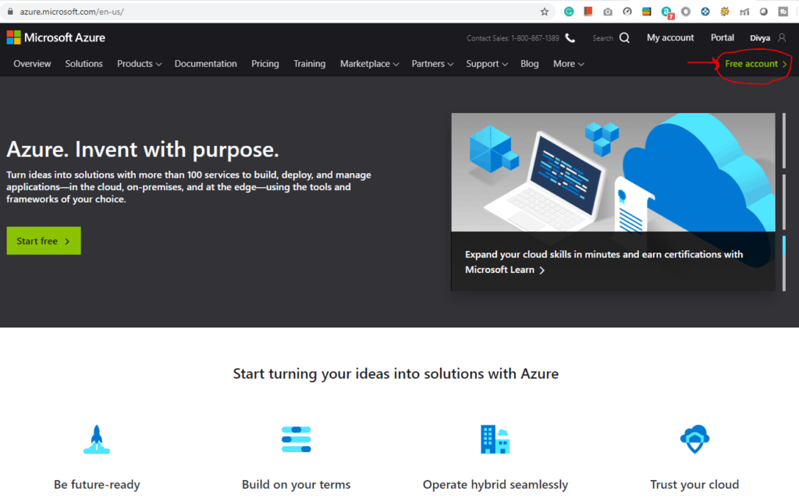
Go to the Azure Home Page.Click on Free Azure Account on the top right corner.
Creating Azure Free Account

Slide 55
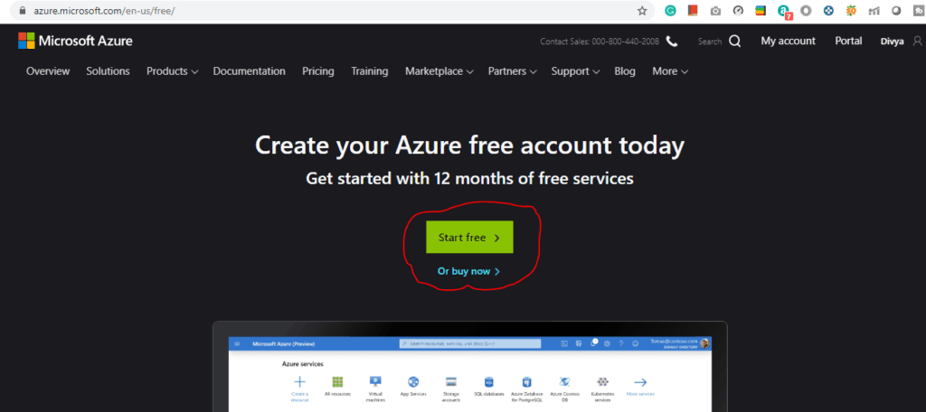
Click on Start Free.
Creating Azure Free Account

Slide 56
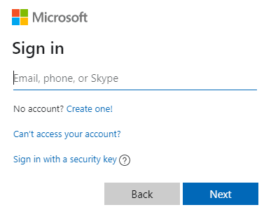
Sign-in/Sign-up for a Microsoft account using an email address and password.
Creating Azure Free Account

Slide 57
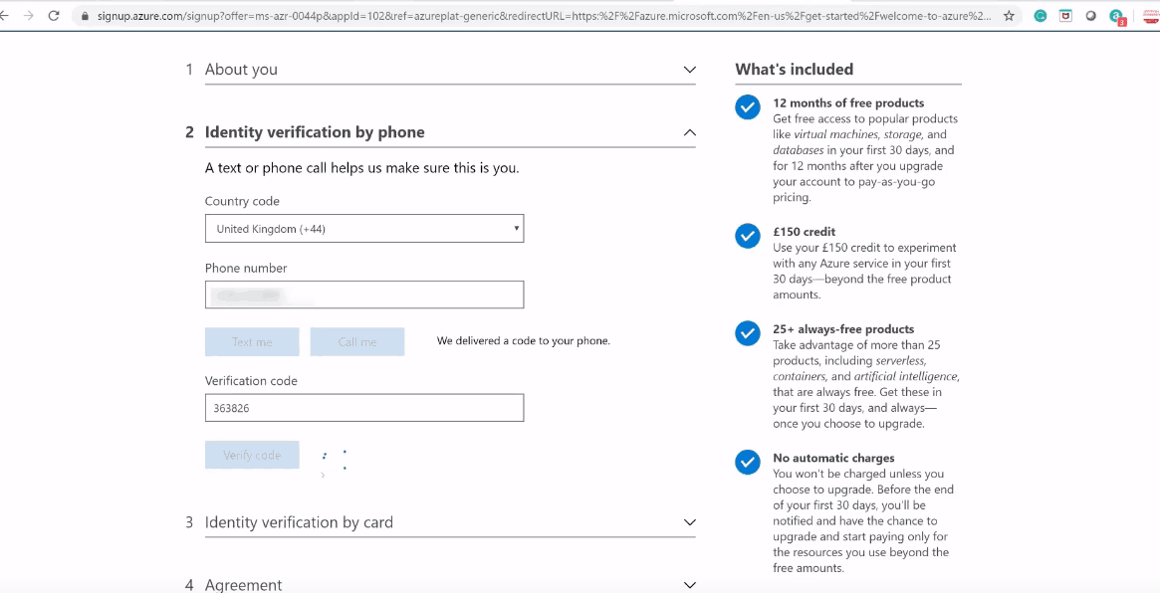
Fill the below details:
Creating Azure Free Account

Slide 58
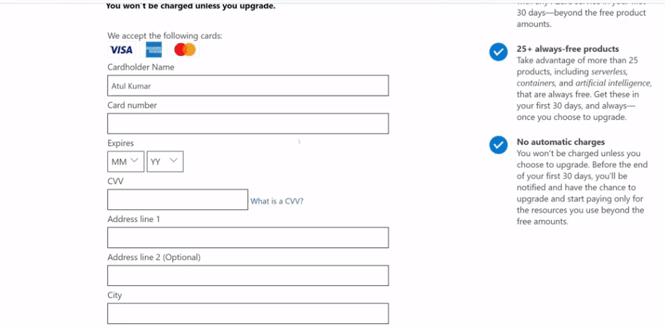
Enter the payment details. Make sure you have a Master Card/American Express/ Visa Credit card and international payments should be enabled.
Creating Azure Free Account

Slide 59
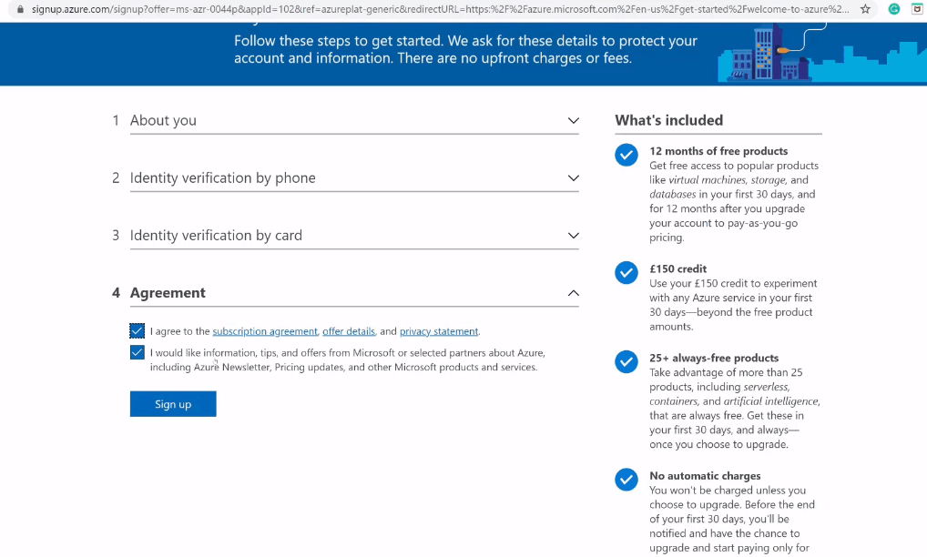
Check the Terms and Conditions and click Sign-up.
Creating Azure Free Account

Slide 60
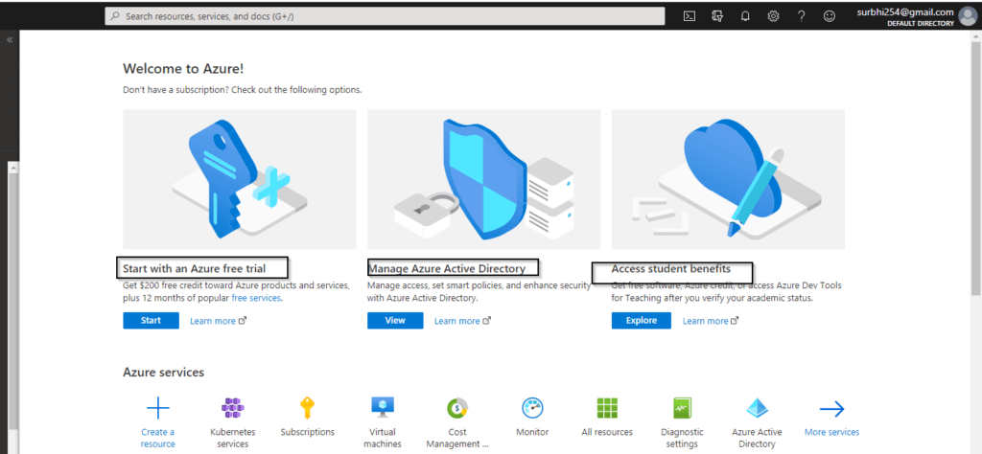
Azure Home Page after registration looks as follows
Creating Azure Free Account

Slide 61
Azure VM

Slide 62
Azure virtual machines are one of several types of on-demand, scalable computing resources that Azure offers. Typically, you choose a virtual machine when you need more control over the computing environment than the other choices offer.
An Azure virtual machine gives you the flexibility of virtualization without having to buy and maintain the physical hardware that runs it. However, you still need to maintain the virtual machine by performing tasks, such as configuring, patching, and installing the software that runs on it.
Azure VM:

Slide 63
Azure virtual machines can be used in various ways. Some examples are:
Development and test
Azure virtual machines offer a quick and easy way to create a computer with specific configurations required to code and test an application.
Applications in the cloud
Because demand for your application can fluctuate, it might make economic sense to run it on a virtual machine in Azure. You pay for extra virtual machines when you need them and shut them down when you don’t.
Extended datacenter
Virtual machines in an Azure virtual network can easily be connected to your organization’s network.
Azure VM:

Slide 64
There's always a multitude of design considerations when you build out an application infrastructure in Azure. These aspects of a virtual machine are important to think about before we start
The names of your resources
The location where the resources are stored
The size of the virtual machine
The maximum number of virtual machines that can be created
The operating system that the virtual machine runs
The configuration of the virtual machine after it starts
The related resources that the virtual machine needs
Choosing a VM

Slide 65
Demo : Azure VM creation

Slide 66
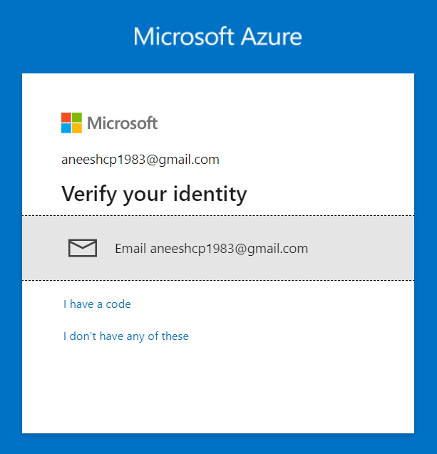
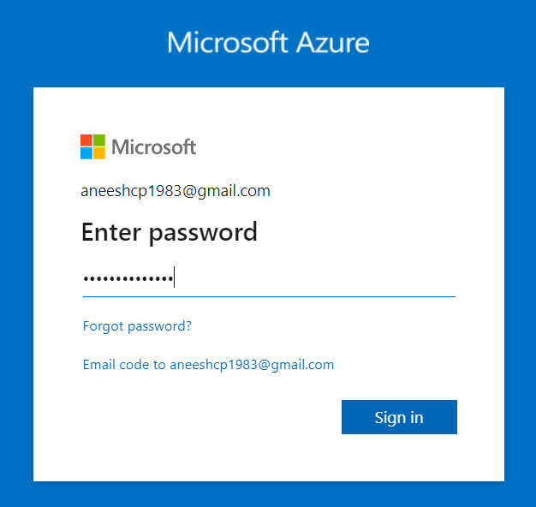
Login to Azure portal with your credentials:
Demo : Creating Azure VM

Slide 67
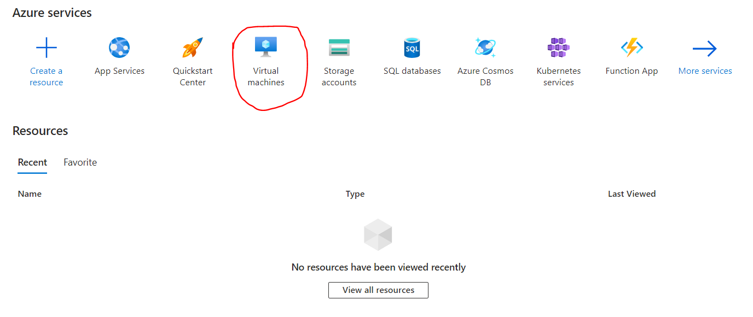
Azure Portal Home page Looks as follows: Select the Virtual Machines.
Demo : Creating Azure VM

Slide 68
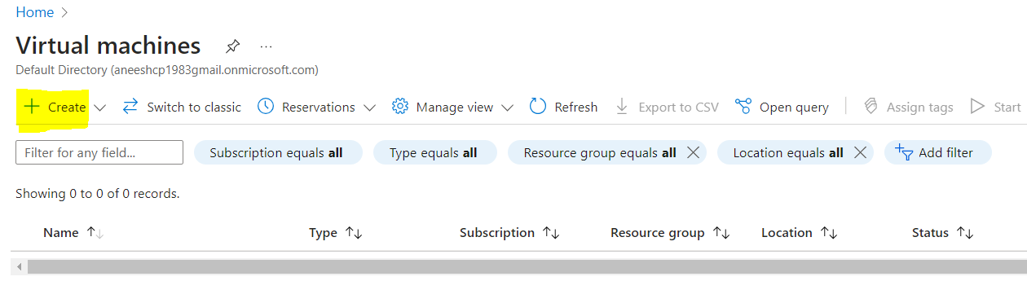
Click CREATE to create a new virtual machine.
Demo : Creating Azure VM

Slide 69
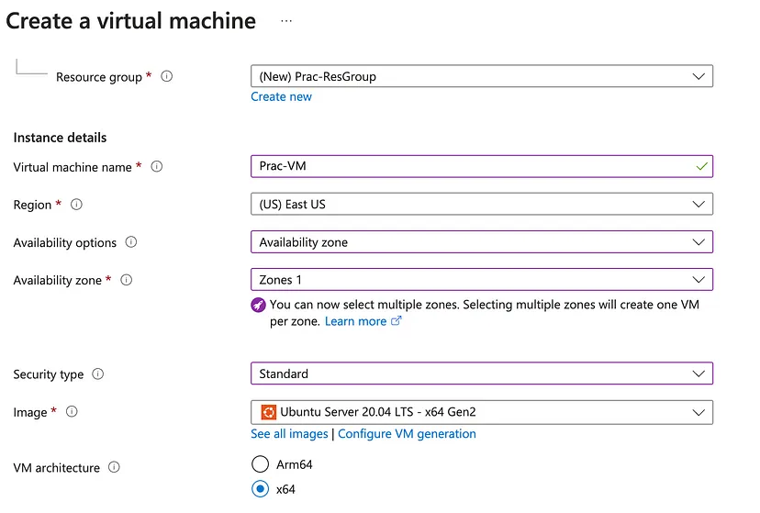
Demo : Creating Azure VM
Configure
the
Following

Slide 70
Under “Size,” select the appropriate configuration for your VM based on CPU, memory, and storage requirements.
Carefully review the available sizes and consider your workload needs.
Demo : Choosing VM Configuration

Slide 71
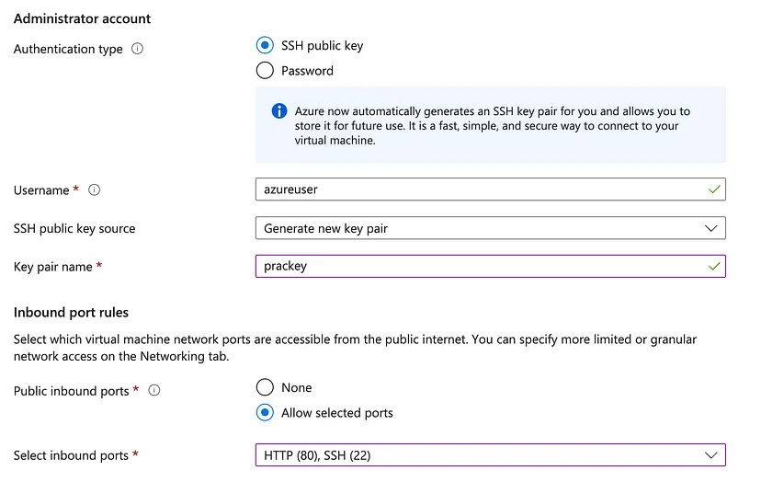
Under “Authentication type,” choose either an SSH public key or a password.
Depending on your choice, provide the necessary credentials.
Configure inbound port rules to allow remote access via SSH or RDP.
Define public inbound ports for external connectivity.
Demo : Setting Up Authentication and Security

Slide 72
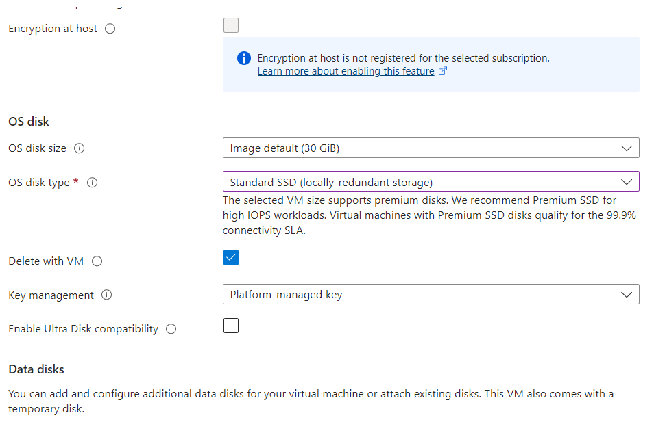
Under “Disks,”
choose the OS disk type (Standard HDD, Standard SSD, Premium SSD).
Adjust the OS disk size according to your needs.
Note: Choose Standard SSD for practice purposes
Demo : Configuring Disks and Storage

Slide 73
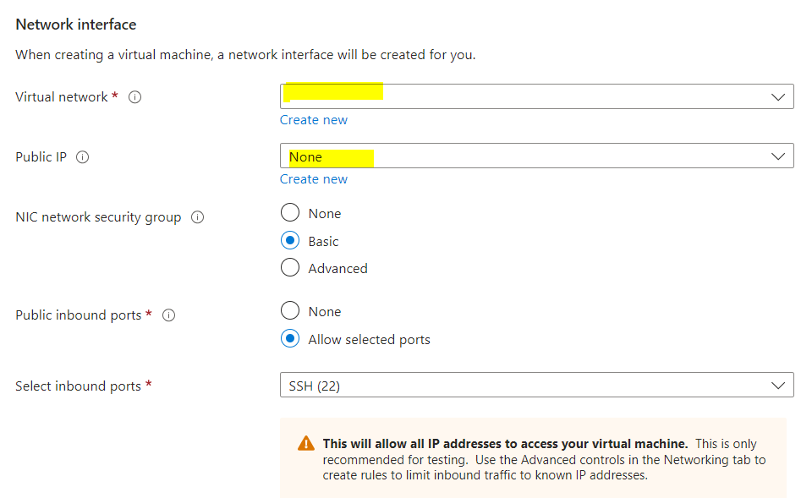
In the “Networking” section:
Choose an existing virtual network and subnet or create new ones.
Assign a public IP address if needed.
Configure network security groups to control traffic.
Demo : Network Configuration

Slide 74
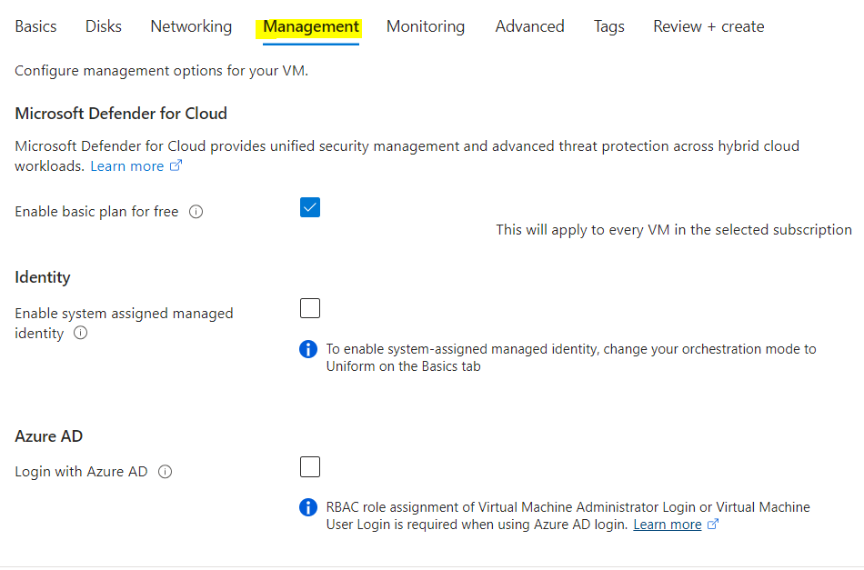
Configure management options for your VM.
Demo : Management

Slide 75
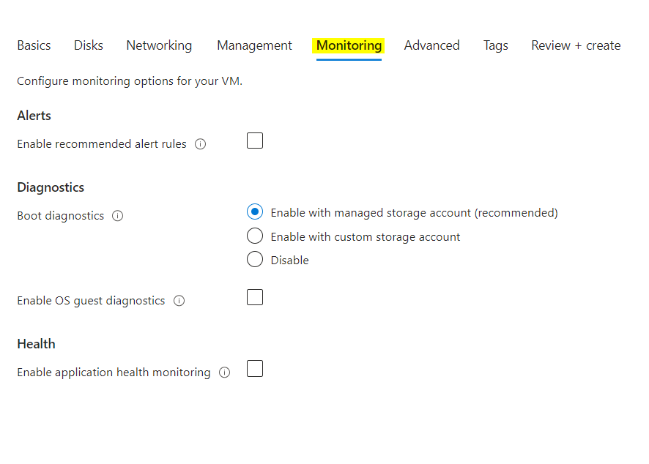
Enable diagnostic settings for monitoring.
Configure boot diagnostics for troubleshooting.
Explore extensions for adding extra functionality.
Demo : Monitoring

Slide 76
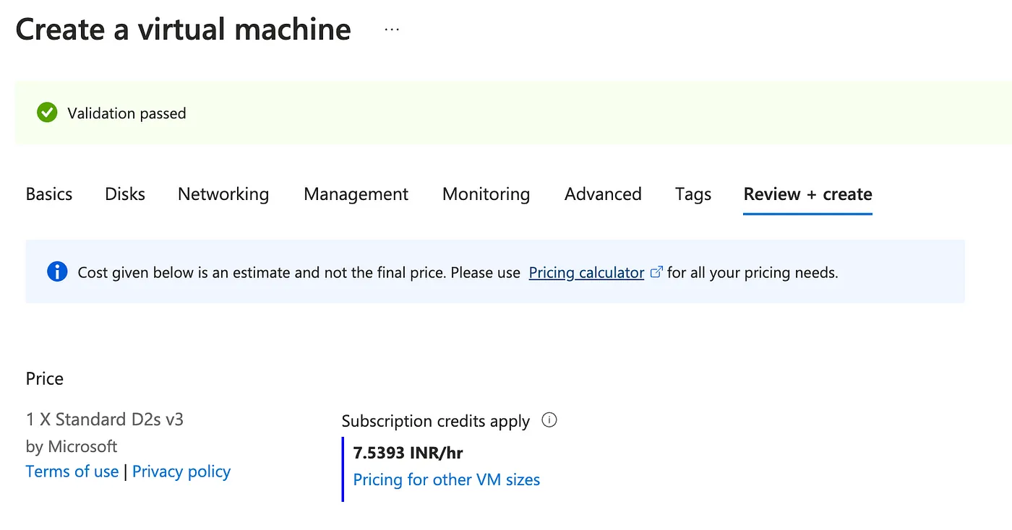
Review all your configuration settings to ensure accuracy.
Validate that your selections align with your intended VM setup.
Demo : Review and Validation

Slide 77
Azure SQL

Slide 78
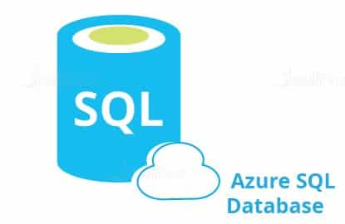
Microsoft Azure SQL Database is a relational database-as-a-service that is reliable and secure, and it gives high performance without having to worry about any infrastructure.It supports relational, JSON, XML data structures.
Microsoft Azure SQL Database has three deployment options:
Single database
Elastic pool
Managed instances
What is Microsoft Azure SQL Database?

Slide 79
Azure SQL Database offers many benefits over traditional on-premises databases, including cost savings, increased flexibility, and scalability.
Perhaps the most significant advantage of Azure SQL Database is its pay-as-you-go pricing model, which can help organizations save money on their database costs.
Azure SQL Database can be scaled up or down as needed, making it a more flexible solution than an on-premises database.
Azure SQL Database is highly available and provides built-in disaster recovery capabilities, ensuring that your data is always safe and accessible.
Why Azure SQL ?

Slide 80
Demo : Azure SQL

Slide 81
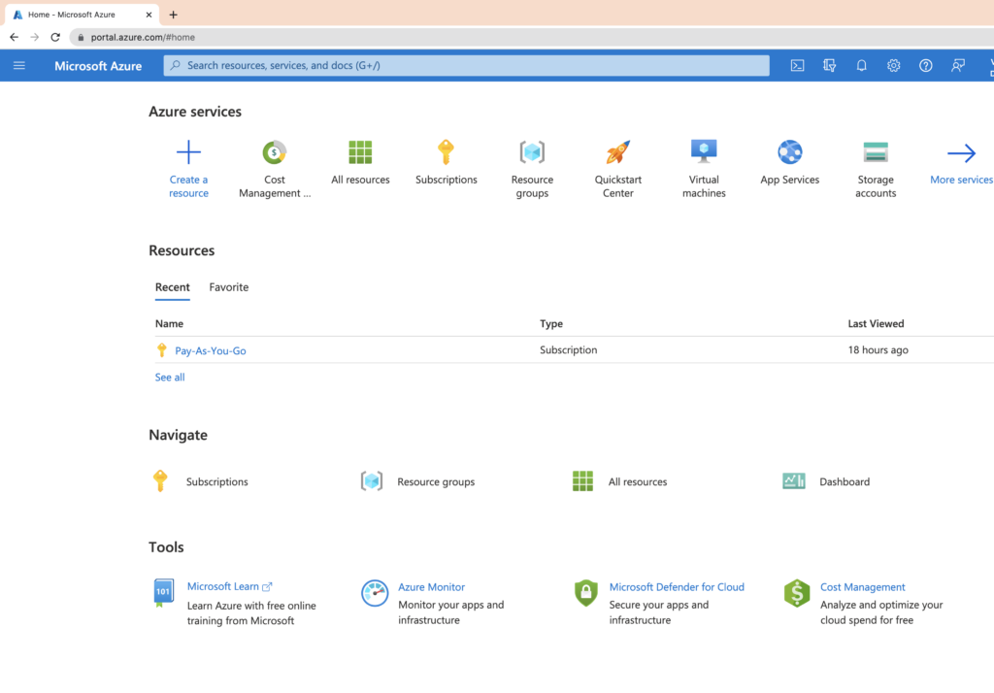
The first step is to navigate to the Azure portal and sign in with your Azure account credentials.
Once you're signed in, you'll see the following page:
Demo : Create Azure SQL Database

Slide 82
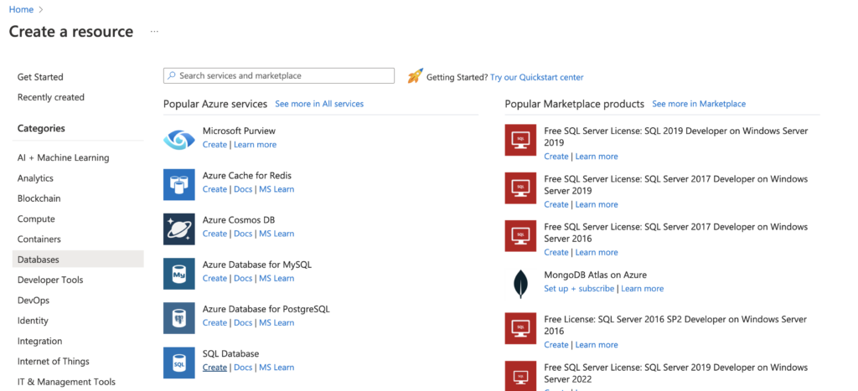
Click on the + Create new resource button, located on the left-hand side of the screen. This will open up the Create a resource blade. Under the Database pane, you can see SQL Database. Click on the Create button located below it.
Demo : Create Azure SQL Database

Slide 83
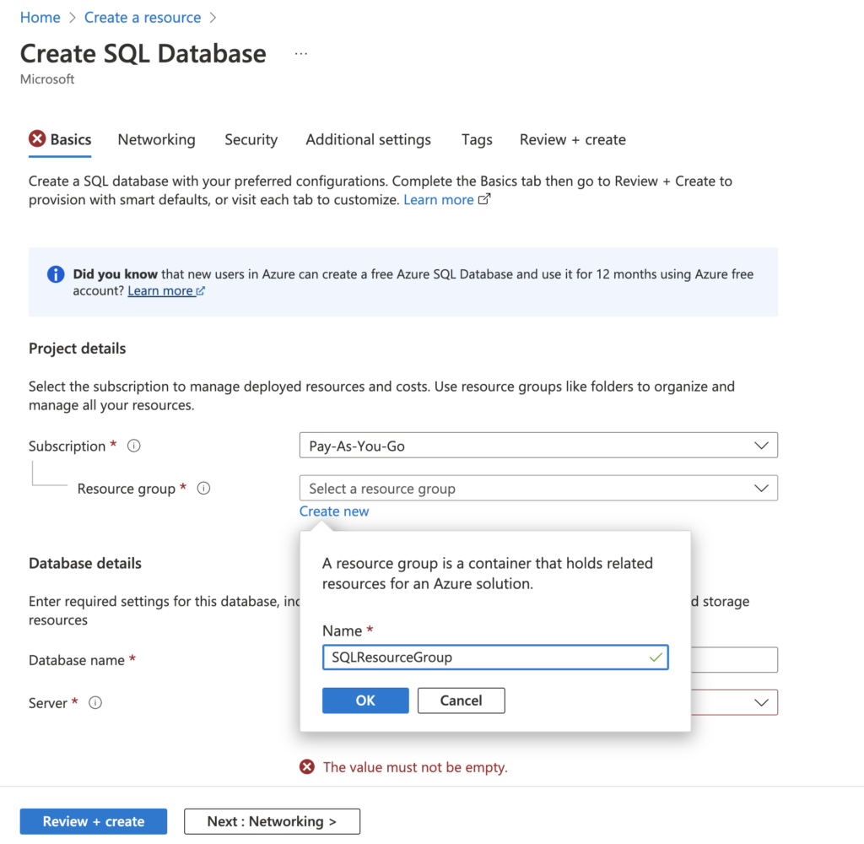
On Create SQL Database blade specify
Subscription
Resource Group
Database Name
Server
Demo : Create Azure SQL Database

Slide 84
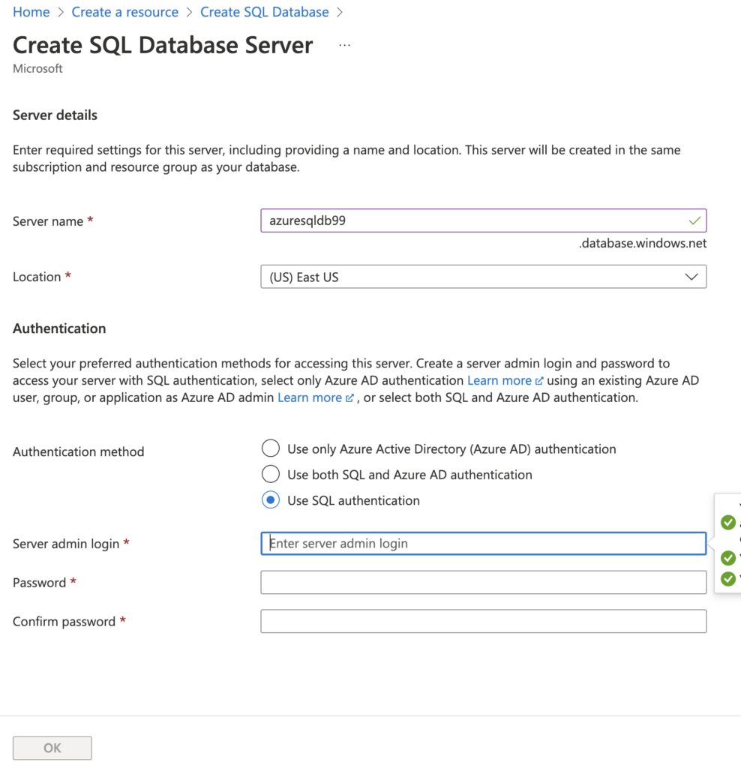
If you do not have a server, you can create one by clicking on the Create new link, which will open the following page. Fill in the details as follows:
Give a unique Server name and select the Location of your choice.
Under Authentication method, select Use SQL authentication option, and create unique Server admin login and Password configurations.
Demo : Create Azure SQL Database

Slide 85
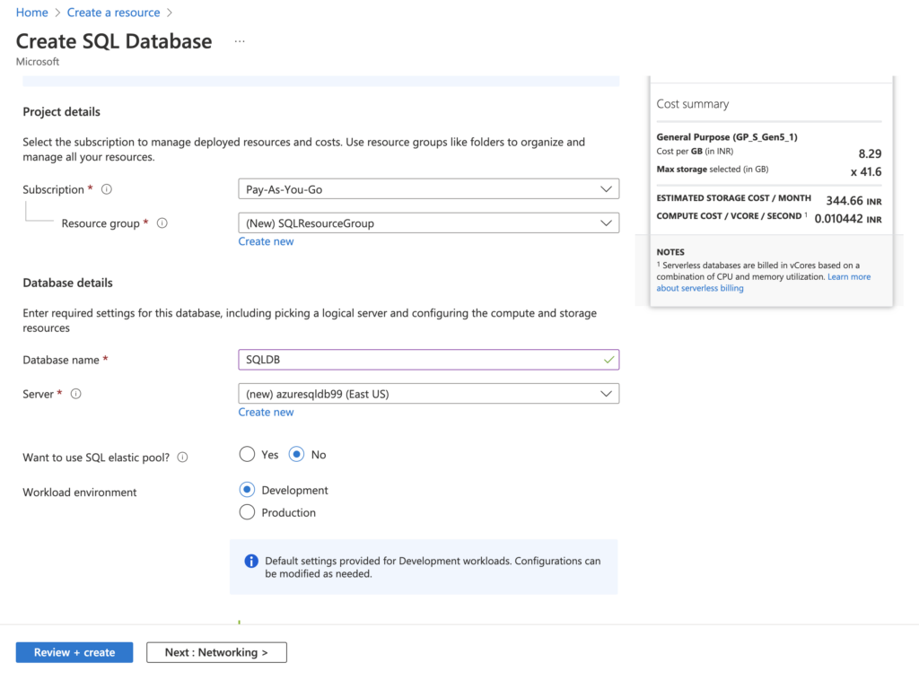
After filling in the details, click OK, which will bring you to the page shown here .
Keep the default settings of No for Want to use SQL elastic pool, and Development for the Workload environment setting.
Demo : Create Azure SQL Database

Slide 86
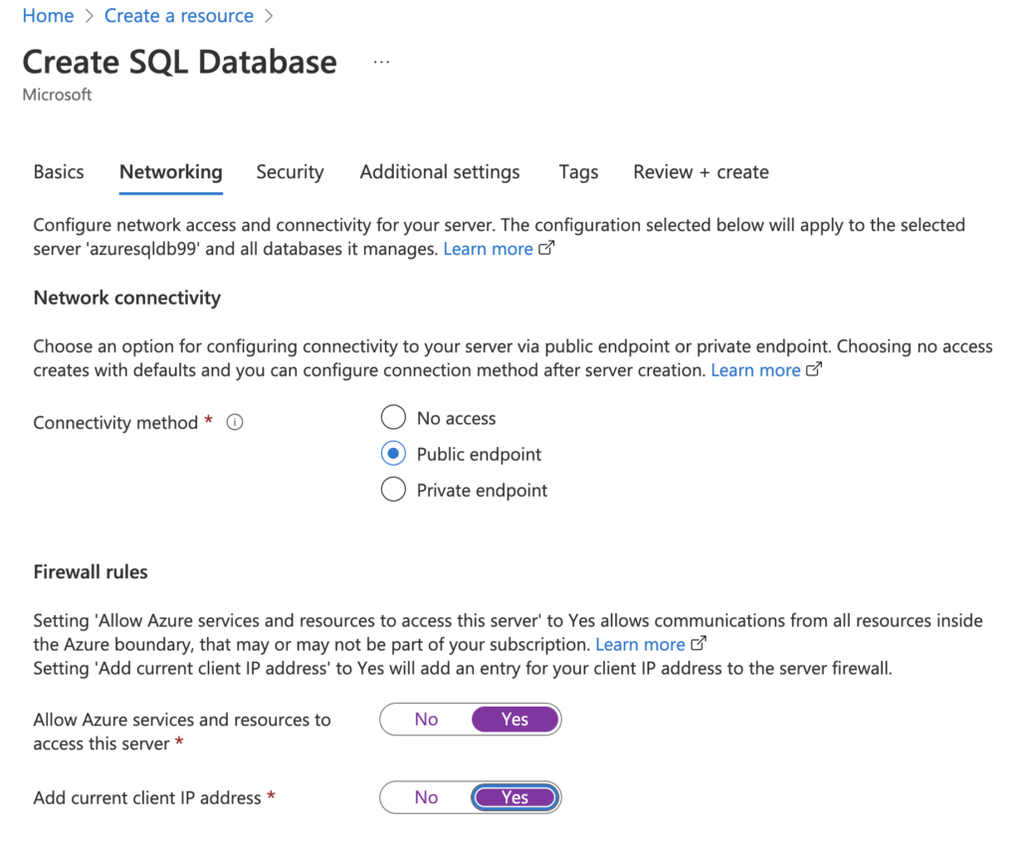
Networking and Configuring settings are as follows.
Demo : Create Azure SQL Database

Slide 87
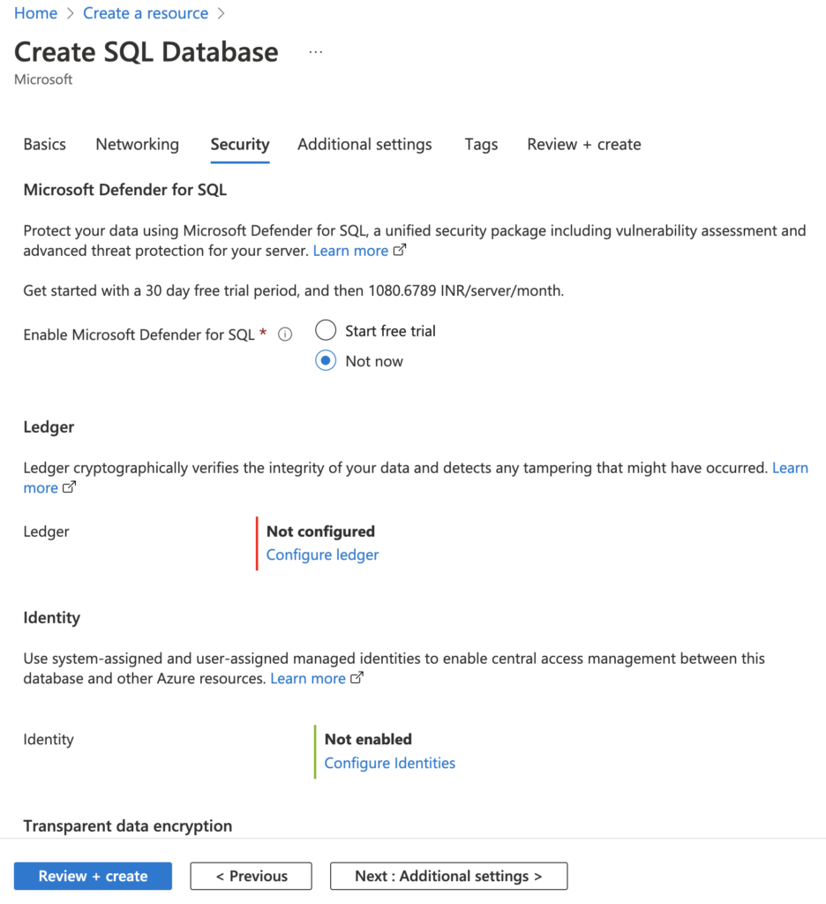
Security:
Leave all other settings to default except Enable Azure Defender for SQL, for which you should choose Not now.
Demo : Create Azure SQL Database

Slide 88
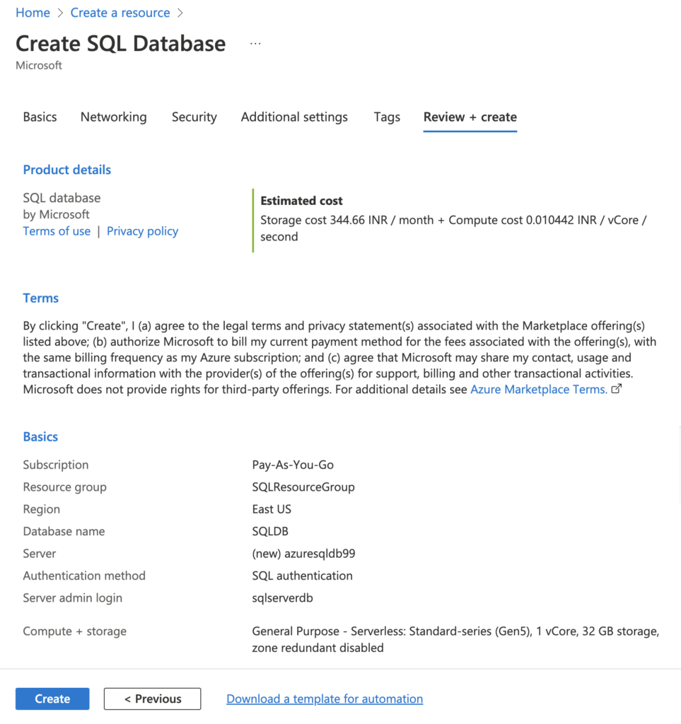
Keep the default settings for other tabs and move to Review + create.
We can review your configurations and go back to edit as needed.
We can also see the estimated cost per month in your currency.
Demo : Create Azure SQL Database

Slide 89
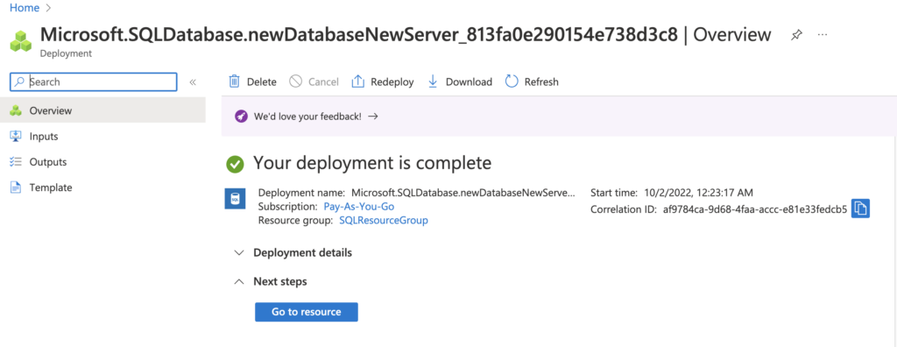
Once we are satisfied with the configurations, click the Create button to deploy your database. It can take a few minutes to complete the deployment. The deployment pane will show the status.
Demo : Create Azure SQL Database

Slide 90
Azure BLOB Storage

Slide 91

Azure Blob Storage is a cloud-based object storage solution offered by Microsoft Azure that allows users to store and manage large amounts of unstructured data in the cloud. With Azure Blob Storage, you can easily store and retrieve text and binary data such as images, videos, and documents, while taking advantage of features such as scalability, security, and cost-effectiveness.
What is Azure BLOB Storage?

Slide 92
Microsoft provides so many storage options, like File, Disk, Archive, etc. Hence it is necessary to understand when one should opt for Blob Storage. Here are the following instances:
Azure Blob Storage is created for storing unstructured data. One can opt for Blob Storage for streaming audio and video files.
Likewise, Blob storage is also used for storing data during backup, archiving, restoring, and recovering. Extensive volume data used for analysis by Azure services are also stored here.
Similarly, one can go for Blob Storage when uploading large files. Azure Blob storage breaks the large files into smaller chunks, and these chunks get uploaded individually. After uploading these chunks, they get merged into a single initial file.
Why Azure BLOB

Slide 93
Blob storage is also used to serve images directly to gateways.
Azure Blob storage also allows the storage of files and documents for providing distributed access.
In addition to it, it can also be used for off-loading excess content from the servers to minimize the load.
It is also used for Big Data analysis by Azure Data Lake, an extension of Azure Blob Storage.
Why Azure BLOB

Slide 94
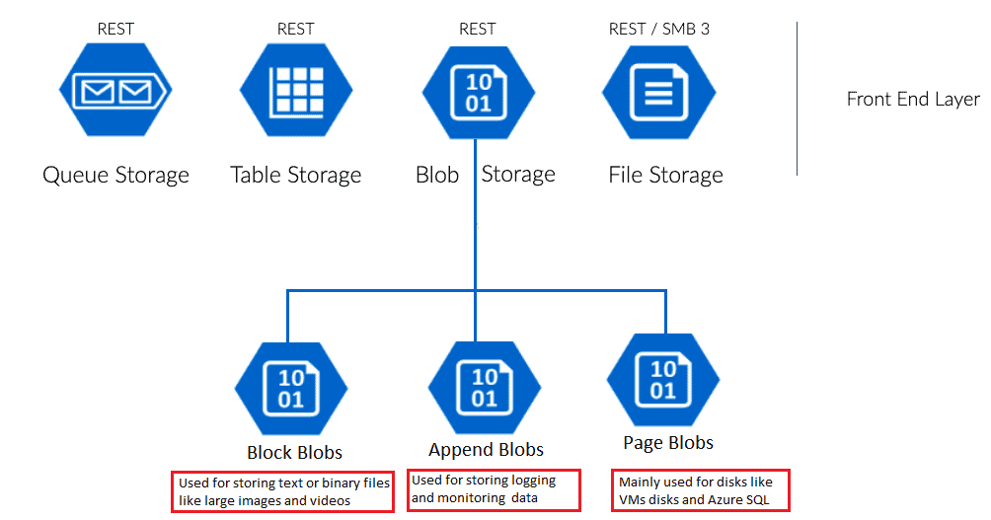
There are three types of Blob Storage, as explained below:
Types of Blob Storage

Slide 95
Block Blob:
The default and most frequent type of Blob Storage is Block Blob. It is intended for the storage of vast amounts of unstructured data, such as text and binary data. Block Blob allows users to upload data in blocks and supports up to 4.75 TB of data per blob, allowing for efficient and reliable uploading and downloading of huge files.
Page Blob:
Page Blob is intended to hold random access files, such as VHD pictures used by virtual machines. It can store up to 8TB of data per blob and allows users to read and write data in arbitrary chunks or pages. This makes it appropriate for cases requiring frequent updates and random data access, such as OS drives or database storage.
Append Blob:
Append Blob is intended for instances in which data must be added to an existing blob, such as logging and auditing. It allows users to append data to the end of the blob without changing the existing data and supports up to 195 GB of data per blob. This allows for the quick and dependable writing of data streams such as log files.
Types of Blob Storage

Slide 96
The vital features of Blob Storage are as follows:
Scalability: Blob Storage can accommodate data of any size, making enormous amounts of unstructured data in the cloud simple to store and manage.
Durability: Blob Storage provides exceptional durability for your data, with multiple copies kept across various data centers to assure data availability and recovery.
Security: Blob Storage protects your data with numerous layers of protection, including encryption at rest and in transit, role-based access control, and shared access signatures.
Cost-effectiveness: Blob Storage offers pay-as-you-go pricing, allowing you to pay only for the storage you need, with no upfront expenditures or termination fees.
Azure Blob Storage Features

Slide 97
Integration: Blob Storage interfaces with other Azure services such as Azure Data Factory, Azure Functions, and Azure Stream Analytics, as well as third-party tools, making it a versatile option for a wide range of use cases.
Object-level Tiering: Blob Storage has hot, cold, and archive tiers that allow users to store and manage data based on its frequency of use and temporal sensitivity.
Advanced Data Management features: Blob Storage enables advanced data management features like as object versioning, deletion policies, lifecycle management, and event-driven workflows.
Azure Blob Storage Features

Slide 98
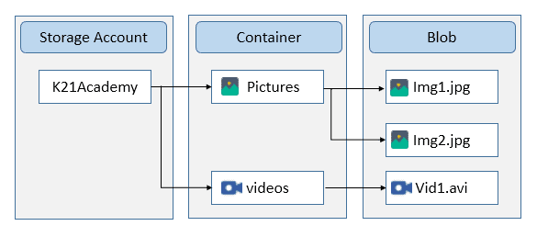
The main components of blob storage are :
Storage Account
Container
BLOB
Components of Azure Blob Storage

Slide 99
Storage Account – In Storage Account, you specify the namespace for the data. Objects stored in Azure Storage will have unique addresses linked to the individual account.
Container – It acts as a directory that helps establish and manage the blobs. The storage account can contain numerous containers, which can hold blobs of various ranges. Container names are always specified in lowercase.
Blob – Blobs are objects in the form of unstructured data, including images, audio, video, and files. The different solutions for migrating the data into the Azure Blob Storage include Azure Data Factory, AzCopy, BlobFuse, Azure Service, Azure Data Box, etc.
Components of Azure Blob Storage

Slide 100
Demo : Azure BLOB Storage

Slide 101
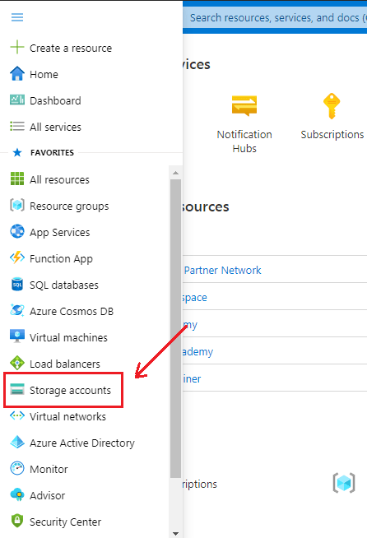
The first and foremost step in creating Blob Storage is setting up the ‘Storage Account’. To create one,
Log in to the Azure portal
Click on ‘Storage Accounts‘.
Demo : Creating Azure BLOB

Slide 102
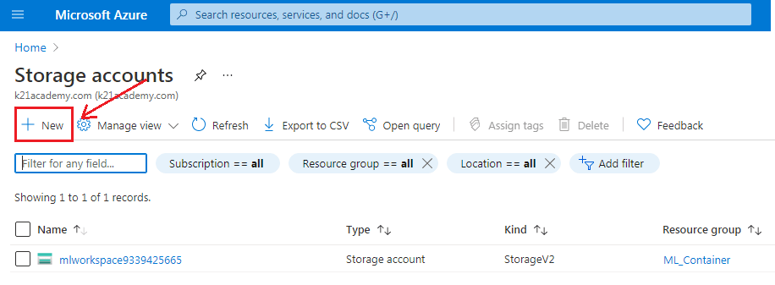
After clicking on Storage Account, the following screen will appear and then click on ‘+ New‘ to proceed further.
Demo : Creating Azure BLOB

Slide 103
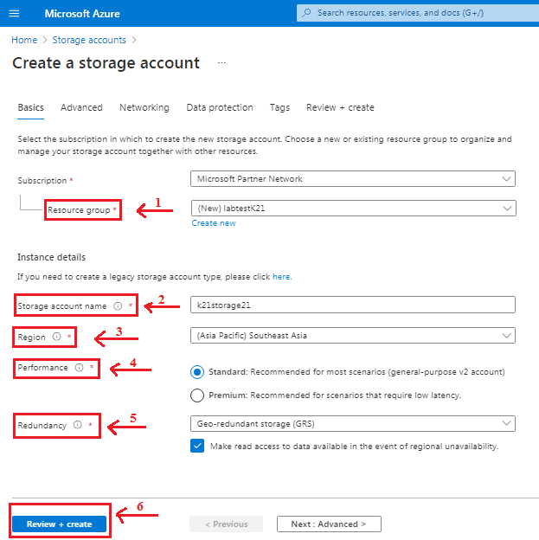
After clicking on New, it will take you to the
next page and asks you to fill in the
following details:
Subscription
Resource Group
Storage Account name
Region
Performance
Redundancy
Demo : Creating Azure BLOB

Slide 104

Azure Storage Account provides four types of Redundancy Storage as shown in the below sample. We will go with Geo-redundant Storage (GRS) for the demo purpose.
Demo : Creating Azure BLOB

Slide 105

When you click on the ‘Create’ button, it takes you to the next screen that shows the deployment status. After deployment gets completed, click on ‘Go to resource‘.
Demo : Creating Azure BLOB

Slide 106

The following screen will appear, showing an ‘Overview’ of the created Storage Account. The next step is to click on ‘Containers‘ to select Blob Storage. We have chosen the ‘Hot Access‘ tier for a demo purpose. One can choose according to their requirements.
Demo : Creating Azure BLOB

Slide 107

Now, we have to create a new Container for that click on ‘+ Container‘.
Demo : Creating Azure BLOB

Slide 108


After clicking on + Container, it will ask to fill in the container’s name (it should be unique) and select access level. CREATE and verify the Container appears in the storage
Demo : Creating Azure BLOB

Slide 109

Select the Storage Account and click on the ‘ Access keys‘ to find the connection string. The website’s code gets authenticated to interact with created Storage Account through these Connection Strings. All you need to do here is copy the connection string and paste it into the website’s code.
Demo : Creating Azure BLOB

Slide 110
Azure Functions

Slide 111

Azure Functions is a serverless computing service provided by Microsoft Azure that allows developers to build and deploy event-driven applications without the need to manage infrastructure.
With Azure Functions, developers can focus solely on writing code to handle specific events, leaving the underlying infrastructure and scaling aspects to the Azure platform. This enables faster development, reduced operational costs, and enhanced scalability.
Azure Functions
Serverless is a term that generally refers to serverless applications. Serverless applications are ones that don’t need any server provision and do not require to manage servers.

Slide 112
Event-driven Computing:
Azure Functions are triggered by various events, such as HTTP requests, timers, messages in queues, file uploads, or changes to data in databases. This event-driven approach allows developers to respond to specific events in real-time without the need to maintain persistent server instances.
Serverless Architecture:
Azure Functions follows the serverless computing paradigm, meaning there are no servers to provision or manage. The platform automatically handles infrastructure scaling, ensuring resources are allocated based on the actual demand, making it highly cost-efficient.
Why to use Azure Functions

Slide 113
Language and Platform Support:
Azure Functions supports multiple programming languages, including C#, JavaScript, Java, Python, and TypeScript. This flexibility allows developers to work with their preferred language and leverage existing codebases seamlessly.
Pay-as-You-Go Pricing:
Azure Functions offer a pay-as-you-go billing model. You only pay for the compute resources used during the execution of your functions. This cost-effective approach ensures you are charged only for the actual usage without any upfront commitments.
Integration with Azure Services:
Azure Functions seamlessly integrate with various Azure services like Azure Storage, Azure Cosmos DB, Azure Service Bus, Azure Event Grid, and more. This integration allows developers to build sophisticated applications by combining the power of different services.
Why to use Azure Functions

Slide 114
HTTP Trigger:
This type of function is triggered by an HTTP request. It can be used to build web APIs and handle HTTP-based interactions.
Timer Trigger:
A timer trigger executes a function on a predefined schedule or at regular intervals. It is useful for performing tasks such as data synchronization, periodic processing, or generating reports.
Blob Trigger:
This type of function is triggered when a new or updated blob is added to an Azure Storage container. It enables you to automate processes based on changes in storage blobs.
Queue Trigger:
A queue trigger is triggered when a message is added to an Azure Storage queue. It provides a way to process messages in a queue-based architecture, allowing you to build event-driven applications.
Types of Azure Functions

Slide 115
Event Grid Trigger:
An event grid trigger is invoked when an event is published to an Azure Event Grid topic or domain. It enables reactive processing of events and can be used to build event-driven architectures.
Cosmos DB Trigger:
This type of function is triggered when there are changes to a document in an Azure Cosmos DB container. It allows you to build real-time data processing and synchronization scenarios.
Service Bus Trigger:
A service bus trigger is invoked when a new message arrives in an Azure Service Bus queue or topic subscription. It is suitable for building decoupled messaging-based systems.
Event Hub Trigger:
An event hub trigger is invoked when new events are published to an Azure Event Hub. It enables high-throughput event ingestion and processing scenarios.
Types of Azure Functions

Slide 116
Demo:Azure Functions

Slide 117

Azure Functions let us execute our code in a serverless environment. This does not require create a solution or publish it as Azure Apps. Let’s make a sample function .
Navigate and Login to your Azure Portal
From New -> Compute -> Select Function App, or Search Function App in the Search the marketplace box
Demo : Creating Azure Function

Slide 118

Then Create the Function App, by providing all required details including App Name, Subscription Details, Hosting Plan etc.
Demo : Creating Azure Function

Slide 119

It may take a while to provision a new Function App. Once the process is completed, you will have the following screen:
Demo : Creating Azure Function

Slide 120

Add a New Function, by clicking on the “+” icon in the Function option
Demo : Creating Azure Function

Slide 121

Selecting New option would launch the quick start page from where you select some predefined scenarios such as Web Hook + API , Timer and Data Processing along with Language – “ C# or Java Script.
Demo : Creating Azure Function
You can also create your own custom function too. For now, select the Webhook + API and C# language and click the “Create this function” button

Slide 122

Function Code / Write Your Custom Code
With that you will find a default HttpTrigger function created. That function is nothing but a self-contained method which accept a HttpRequestMessage and return HttpResponseMessage.
Demo : Creating Azure Function

Slide 123

Click on the </> Get Function URL button in the top-right corner, it will show you the Function URL.
Demo : Test Your Azure Function

Slide 124

Use the URL from any of your client application and pass the required parameter! Following screenshots shows using the Azure Function from Postman Client.
Demo : Test Your Azure Function

Slide 125

Select the Monitor Tab in the tree, to view details of Invocation Log for your function
Demo : Monitor Your Azure Function

Slide 126
Azure Storage Queue

Slide 127

Azure Queue Storage is a service for storing large numbers of messages. You access messages from anywhere in the world via authenticated calls using HTTP or HTTPS. A queue message can be up to 64 KB in size. A queue may contain millions of messages, up to the total capacity limit of a storage account.
Queues are commonly used to create
a backlog of work to process
asynchronously, like in the
Web-Queue-Worker architectural style.
What is Azure Queue Storage?

Slide 128

Queue Storage contains the following components:
URL format: Queues are addressable using the following URL format:
https://<storage account>.queue.core.windows.net/<queue>
Storage account:
All access to Azure Storage is done through a storage account. For information about storage account capacity, see Scalability and performance targets for standard storage accounts.
Azure Queue Storage Components

Slide 129
Queue:
A queue contains a set of messages. The queue name must be all lowercase. For information on naming queues, see Naming queues and metadata.
Message:
A message, in any format, of up to 64 KB. Before version 2017-07-29, the maximum time-to-live allowed is seven days. For version 2017-07-29 or later, the maximum time-to-live can be any positive number, or -1 indicating that the message doesn't expire. If this parameter is omitted, the default time-to-live is seven days.
Azure Queue Storage Components

Slide 130
Demo:Azure Storage Queue

Slide 131

Navigate to your new storage account in the Azure portal.
On the Queue Storage section, select Queues.
Type a name for your new queue. The queue name must be lowercase, must start with a letter or number, and can include only letters, numbers, and the dash (-) character.
Demo : Creating Azure Queue

Slide 132
Select the new queue from the list of queues in the storage account.
Select the + Add message button to add a message to the queue. Enter a message in the Message text field.
Specify when the message expires. Valid values that can be entered in the Expires in field are between 1 second and 7 days. Select Message never expires to indicate a message that will remain in the queue until it is explicitly removed.
Indicate whether to encode the message as Base64. Encoding binary data is recommended.
Select the OK button to add the message.
Azure Queue : Adding a message

Slide 133

Sample Screen :
Azure Queue : Adding a message

Slide 134

After you add a message, the Azure portal displays a list of all of the messages in the queue. You can view the message ID, the contents of the message, the message insertion time, and the message expiration time. You can also see how many times this message has been dequeued.
Azure Queue : View message properties

Slide 135

You can dequeue a message from the front of the queue from the Azure portal. When you dequeue a message, the message is deleted.
Dequeuing always removes the oldest message in the queue.
Azure Queue : Dequeue a message

Slide 136
Azure API Gateway

Slide 137

Azure API Gateway is a fully managed, serverless API management service provided by Microsoft Azure.It serves as an entry point for your APIs and acts as an intermediary between your clients and your back-end services.
What is Azure API Gateway ?
Azure API Gateway offers a range of features that allow you to secure, publish, and analyze your APIs, making it easier to manage and scale your API infrastructure.

Slide 138
API Management:
Azure API Gateway provides a central platform for managing your APIs. It offers tools for designing, deploying, and scaling your APIs effectively. This centralized control simplifies the process of versioning, monitoring, and securing your APIs.
Security and Authentication:
Security is paramount in the world of APIs. Azure API Gateway offers various authentication and authorization mechanisms, including OAuth, API keys, and client certificates, to ensure that your APIs are accessible only by authorized users or applications.
Rate Limiting:
You can set rate limits on your APIs to prevent abuse and ensure fair usage. This feature allows you to control the number of requests clients can make within a specific time frame.
Why Azure API Gateway ? (The Features )

Slide 139
Caching:
Caching is essential for optimizing the performance of your APIs. Azure API Gateway includes caching capabilities that reduce the load on your back-end services by storing and serving frequently requested data.
Transformation and Routing:
You can modify the request and response data of your APIs through request and response transformations. Additionally, Azure API Gateway supports routing and URL rewriting, which can be helpful in orchestrating complex API requests.
Monitoring and Analytics:
Azure API Gateway offers robust monitoring and analytics features, enabling you to gain insights into the usage and performance of your APIs. You can track metrics, detect issues, and fine-tune your APIs for optimal performance.
Scalability:
One of the advantages of Azure API Gateway is its ability to scale automatically based on the demand for your APIs. This ensures high availability and performance during traffic spikes.
Why Azure API Gateway ? (The Features )

Slide 140
Azure API Gateway operates as a reverse proxy that receives API requests from clients and forwards them to the appropriate back-end services. The process typically involves the following steps:
Request Reception: When a client sends a request to your API, it is first received by the Azure API Gateway.
Request Processing: The gateway can perform various operations, such as authentication, routing, request transformation, and rate limiting, on the incoming request.
Forwarding to Back-end Services: Once the request is processed, the gateway forwards it to the designated back-end service.
Response Processing: The response from the back-end service can also be modified before being sent back to the client.
Response to Client: Finally, the Azure API Gateway sends the processed response to the client.
How Azure API Gateway Works

Slide 141
Demo : Azure API Gateway

Slide 142

Log into Azure Portal:
From the Azure portal menu, select Create a resource. You can also select Create a resource on the Azure Home page.
Creating and Publishing Azure API Gateway

Slide 143

On the Create a resource page, select Integration > API Management.
Creating and Publishing Azure API Gateway

Slide 144

On the Create API Management page,
on the Basics tab, enter settings such as
Subscription
Resource group
Region
Resource name
Organization name
Administrator email
Pricing tier
Creating and Publishing Azure API Gateway

Slide 145

In your API Management instance, search and select API Management services.
Creating and Publishing Azure API Gateway

Slide 146

On the API Management services page, select your API Management instance.
Creating and Publishing Azure API Gateway

Slide 147

Review the properties of your service on the Overview page.
Creating and Publishing Azure API Gateway

Slide 148

In the left navigation of your API Management instance, select APIs.
Select the OpenAPI tile.
In the Create from OpenAPI specification window, select Full.
Enter the values from the following table.
You can set API values during creation or later by going to the Settings tab.
Import and publish your first API

Slide 149
You can call API operations directly from the Azure portal, which provides a convenient way to view and test the operations. In the portal's test console, by default, APIs are called by using a key from the built-in all-access subscription. You can also test API calls by using a subscription key scoped to a product.
In the left navigation of your API Management instance, select APIs > Demo Conference API.
Select the Test tab, and then select GetSpeakers. The page shows Query parameters and Headers, if any.
In the HTTP request section, the Ocp-Apim-Subscription-Key header is filled in automatically for you, which you can see if you select the "eye" icon.
Test the new API in the Azure portal

Slide 150

Select Send and verify that the backend responds with 200 OK and some data.
Test the new API in the Azure portal

Slide 151
Azure Security Guidelines

Slide 152

One can ensure more strong Azure security with the below points but can not rely completely on them. Below are the best practice points that I feel will be beneficial for you to make your Azure much secure and strong.
1) Manage Your Workstations
Best Practices for Azure Security
Daily a person needs to access multiple websites over the Internet. Suppose you are accessing some confidential information. At the same time, you are accessing some unknown file from the open internet containing some malware. How will it impact your business? You might be an easy target for hackers to inject malware and get access to confidential data. The only solution is to use dedicated workstations for sensitive and normal daily tasks.

Slide 153

2) Use Multiple Authentication
It’s always a security concern to strengthen the authentication process to restrict hackers from trying any phishing or brute force attacks. There is no way to make your system completely secure, but you can make it much stronger. Some basic things like complex passwords and Multi-Factor Authentication help make your simple authentication process strong and secure. Azure gives you the flexibility to use their directory service called Azure Active Directory to safeguard your authentication. The user with Azure Active Directory admin access should also enable Multi-Factor Authentication too.
Best Practices for Azure Security

Slide 154
3) Secure Administrator Access
Accounts with all access are highly prone to risks. You should frequently check accounts with administrative privileges at regular intervals. You should block all unnecessary access to these accounts. Privileged Identity Management is an Azure Active Directory service to manage, analyze and control access in your organization. Using this, users have to follow an activation process that will grant administrator rights for a limited time.
4) Secure Networking
Systems and resources that are accessed directly through the internet are more prone to security threats. So it is important to ensure the security of these resources that can lead to threats to other resources. The RDP port is accessible to the public internet for Windows virtual machines, and for Linux, the SSH port is open. All the open ports must be properly restricted and locked to reduce unauthorized access.
Best Practices for Azure Security

Slide 155

5) Monitor Activity Log Alerts
Activity logs are crucial in finding any threats that occurred in the system. Any unrecognized event can lead to severe issues, so it is better to identify those beforehand. Create some activity log alerts in your system that will notify you of security threats. Here are a few cases that are crucial for your security. And it would be best if you created alerts on them.
Azure Security Alerts
Changes or modifications in Security Solution and Security Policy and Policy Assignment.
Any changes or modifications in Network Security Group, including deletion.
Changes or modifications in Network Security Group Rule including deletion.
Any changes or modifications in Firewall and rules.
Changes or modifications in SQL Server Firewall rule.
Best Practices for Azure Security

Slide 156

6) Key Management
All the confidential information like passwords are encrypted into keys. These are much secure and act as a password for any security check. But keys need to be properly encrypted and safeguarded to prevent any misuse and loss of keys. Secure key management is a must to protect cloud data.
7) Secure Storage
Storage is the key component in your system that stores data. The security of storage is one of the most important aspects on its own. To eliminate data theft risk, Azure Disk Encryption restricts unauthorized data access. BitLocker on Windows and DM-Crypt on Linux is used by disk encryption to encrypt data drives and operating systems.
Best Practices for Azure Security

Slide 157

8) Use a WAF with ATM
Azure Web Application Firewall (WAF) is built on top of the Application Gateway service and prevents OWASP 3.0 attacks against Azure SQL databases.
Use a filter in Azure Traffic Manager (ATM) to lock down your web app if it is not required to be accessed internationally.
Best Practices for Azure Security

Slide 158

What is Cloud Computing?
What is Azure?
What are the Azure Prominent Services?
Check Your Understanding

Slide 159

Question & Answer

Slide 160
Some Reference Links
https://aws.amazon.com/
Reference Materials

Slide 161
Aneesh C P

